Slide 1
POWER BI BY MICROSOFT
TEXT FUNCTIONS IN POWER QUERY

Slide 2
POWER QUERY
Power Query is a data transformation and preparation tool built into Microsoft Excel and Microsoft Power BI
It lets you connect to data from many sources, clean and reshape it, and then load it into Excel or Power BI

Slide 3
FOLLOWING TEXT FUNCTION
Merging Columns in Power Query
Split and Trim Functions
Upper case, Lower case and Proper case
Adding Prefixes and Suffixes
Left, Right and Mid Functions in Power Query
Extracting Text with Delimiters

Slide 4
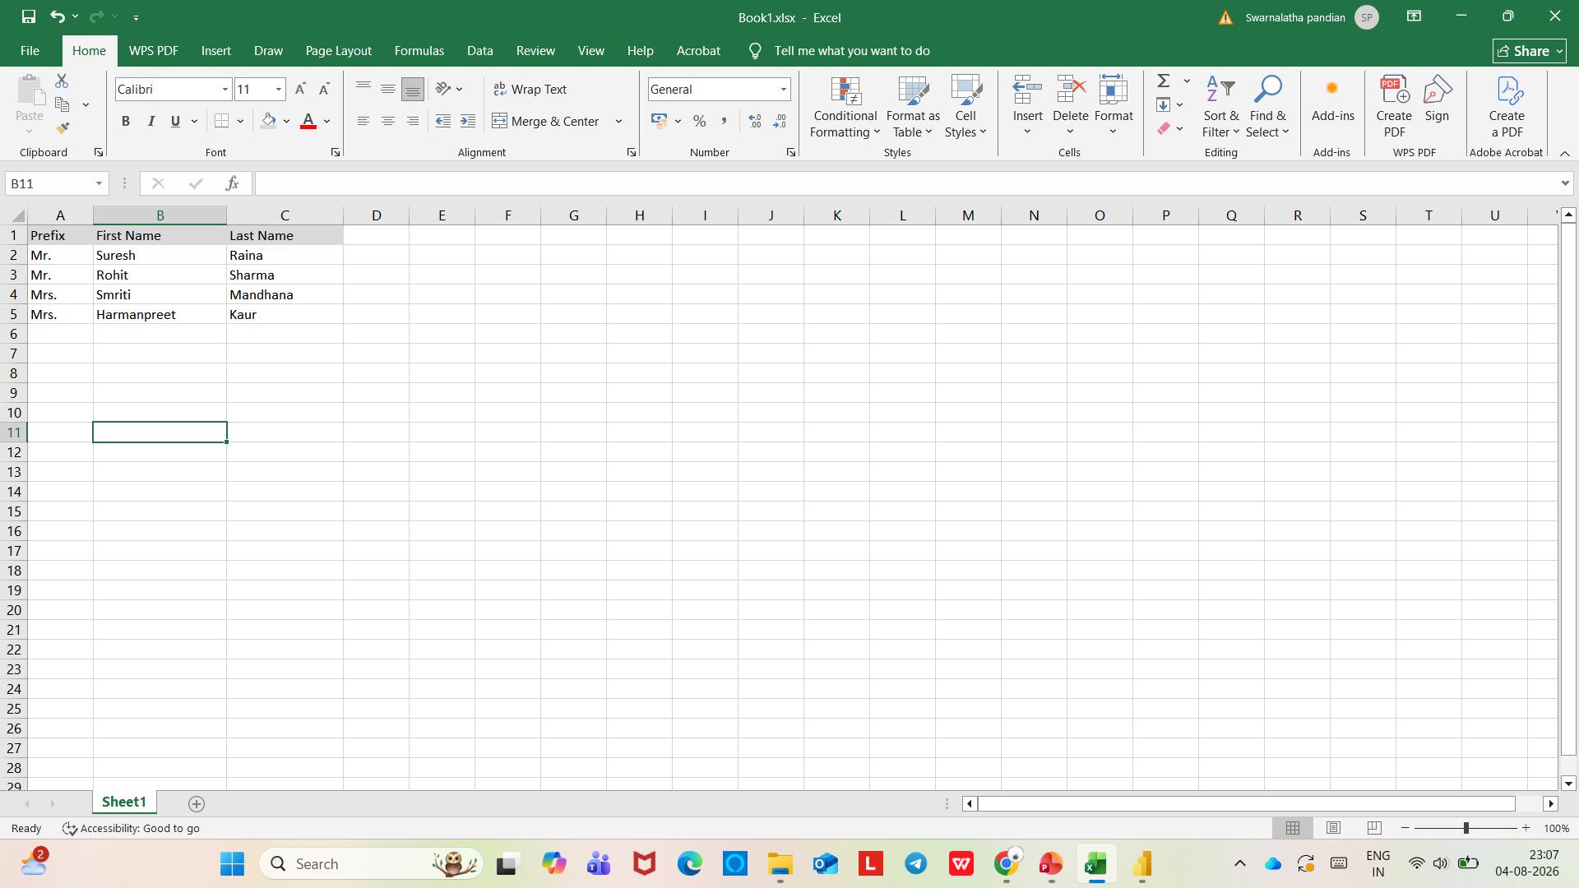
MERGING COLUMNS IN POWER QUERY

Slide 5
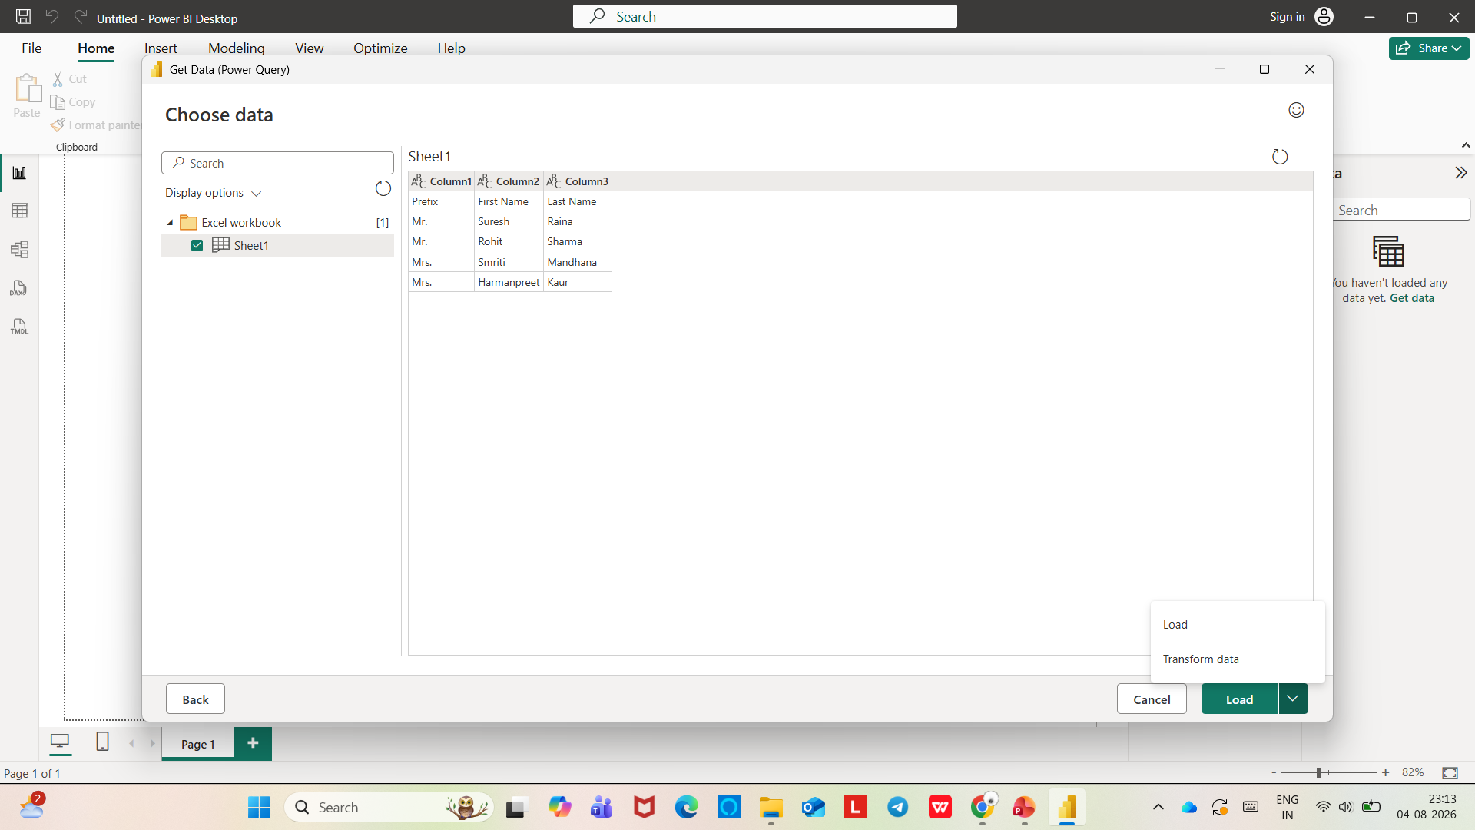

Slide 6
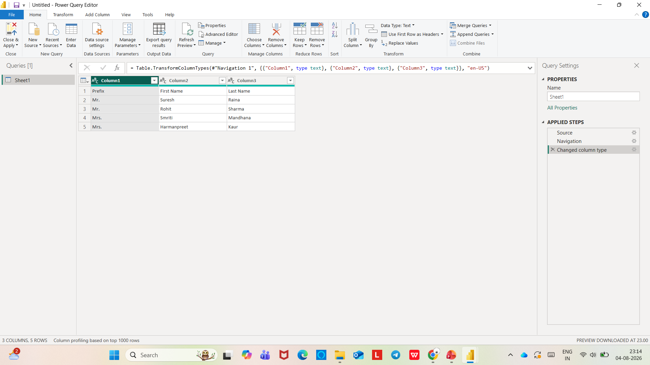

Slide 7
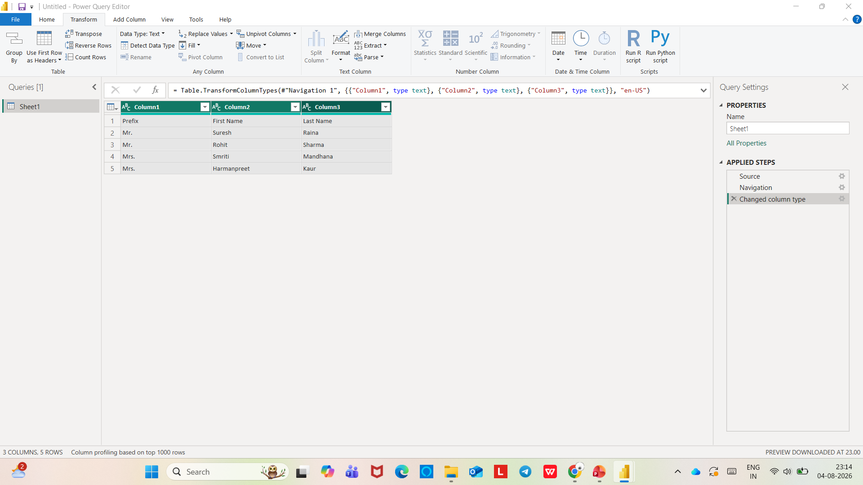

Slide 8
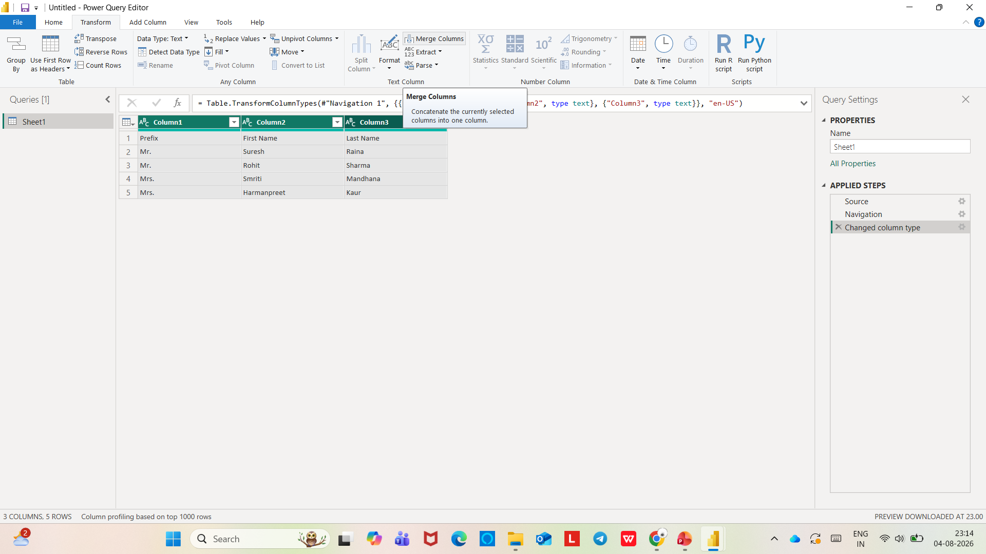

Slide 9
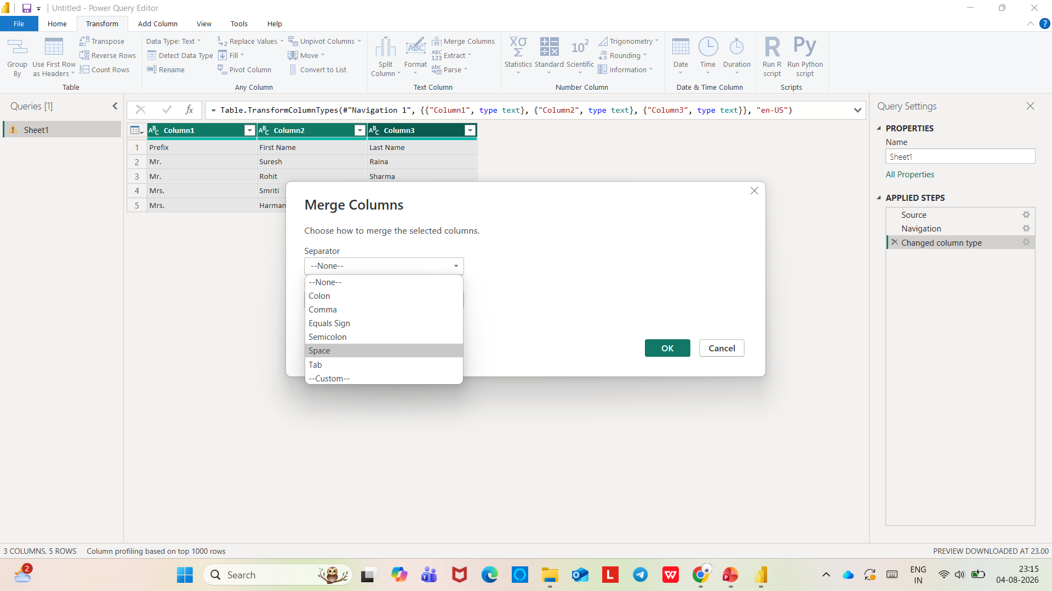

Slide 10
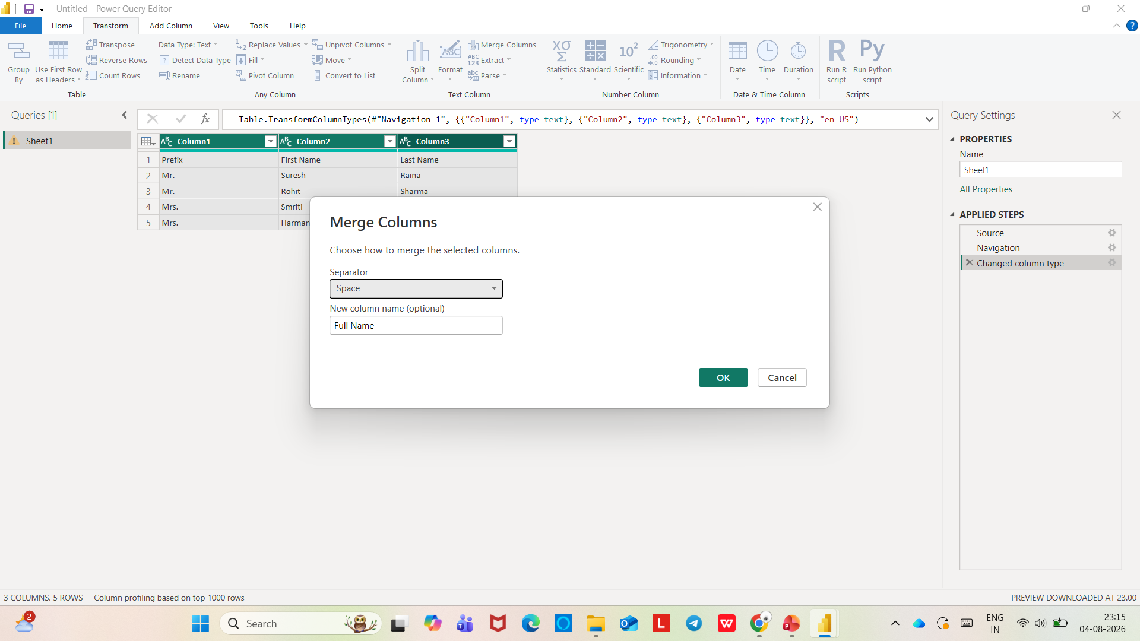

Slide 11
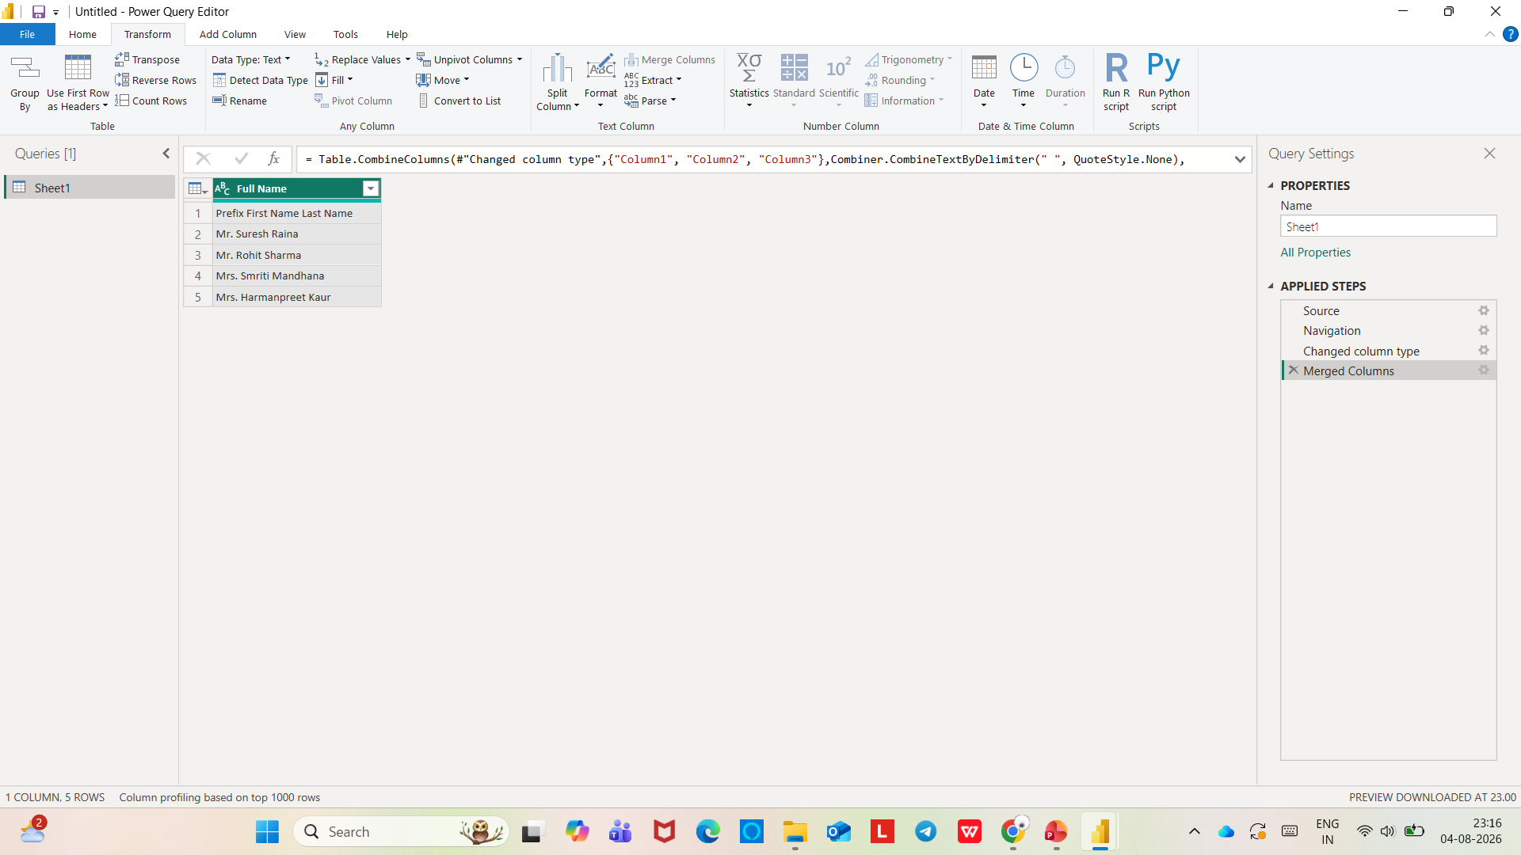

Slide 12
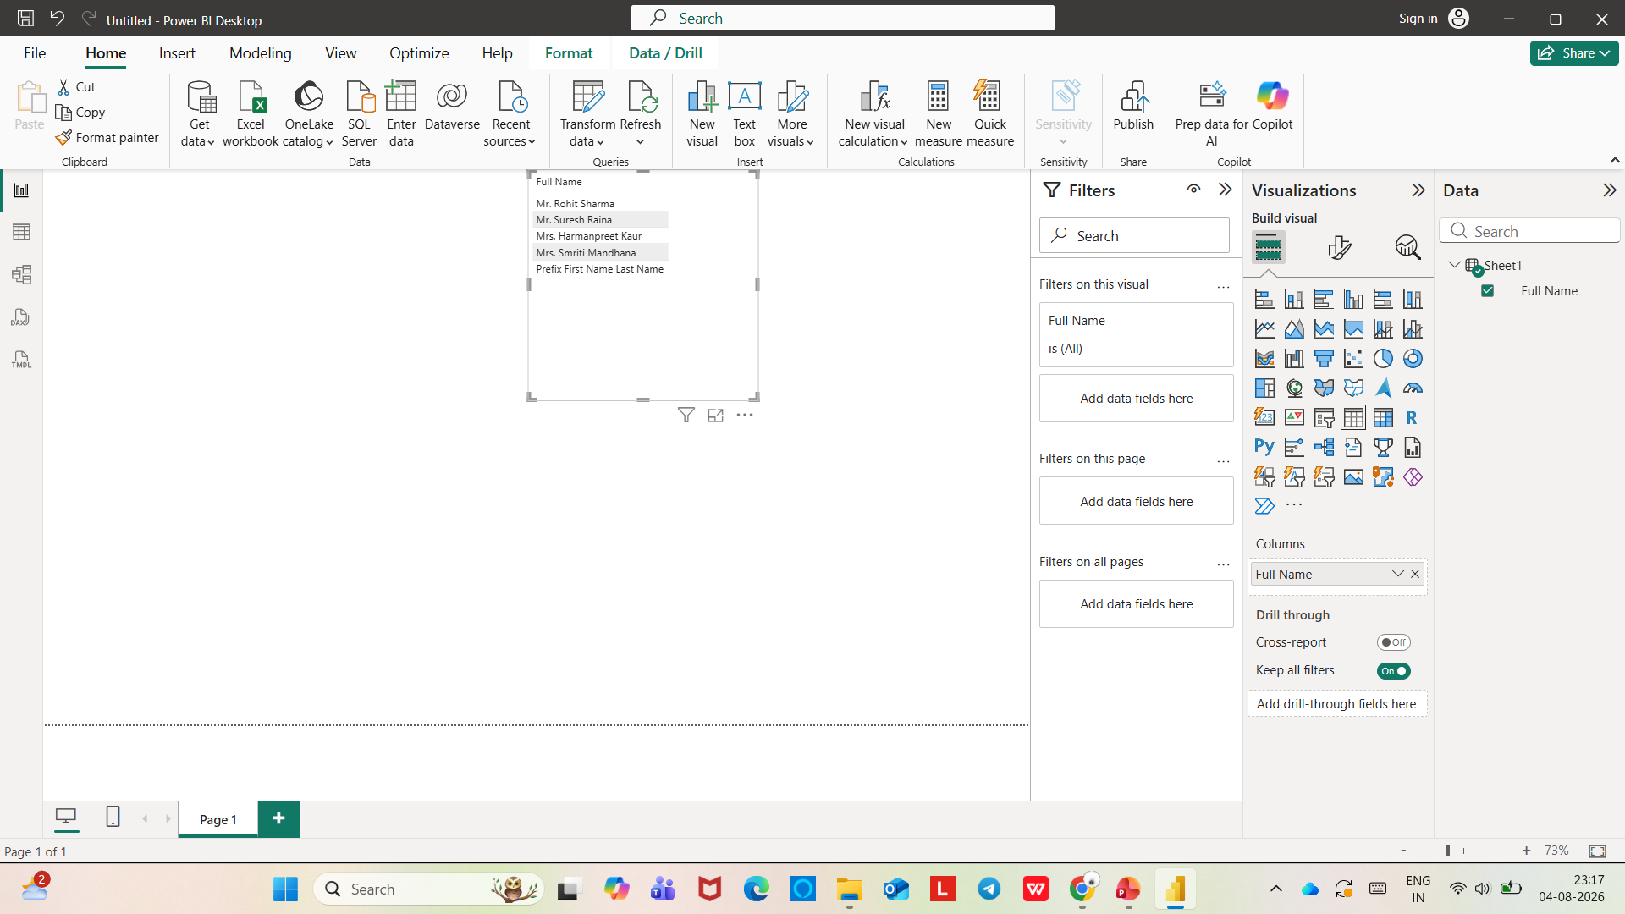

Slide 13
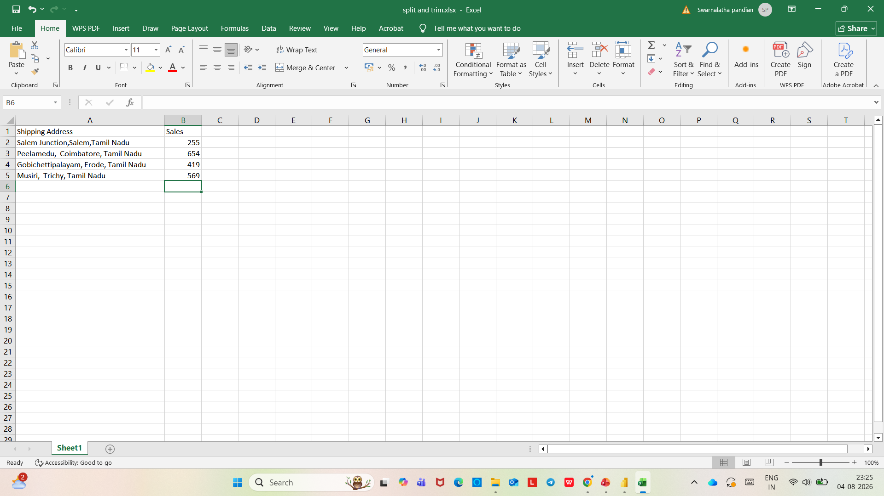
SPLIT AND TRIM FUNCTION

Slide 14
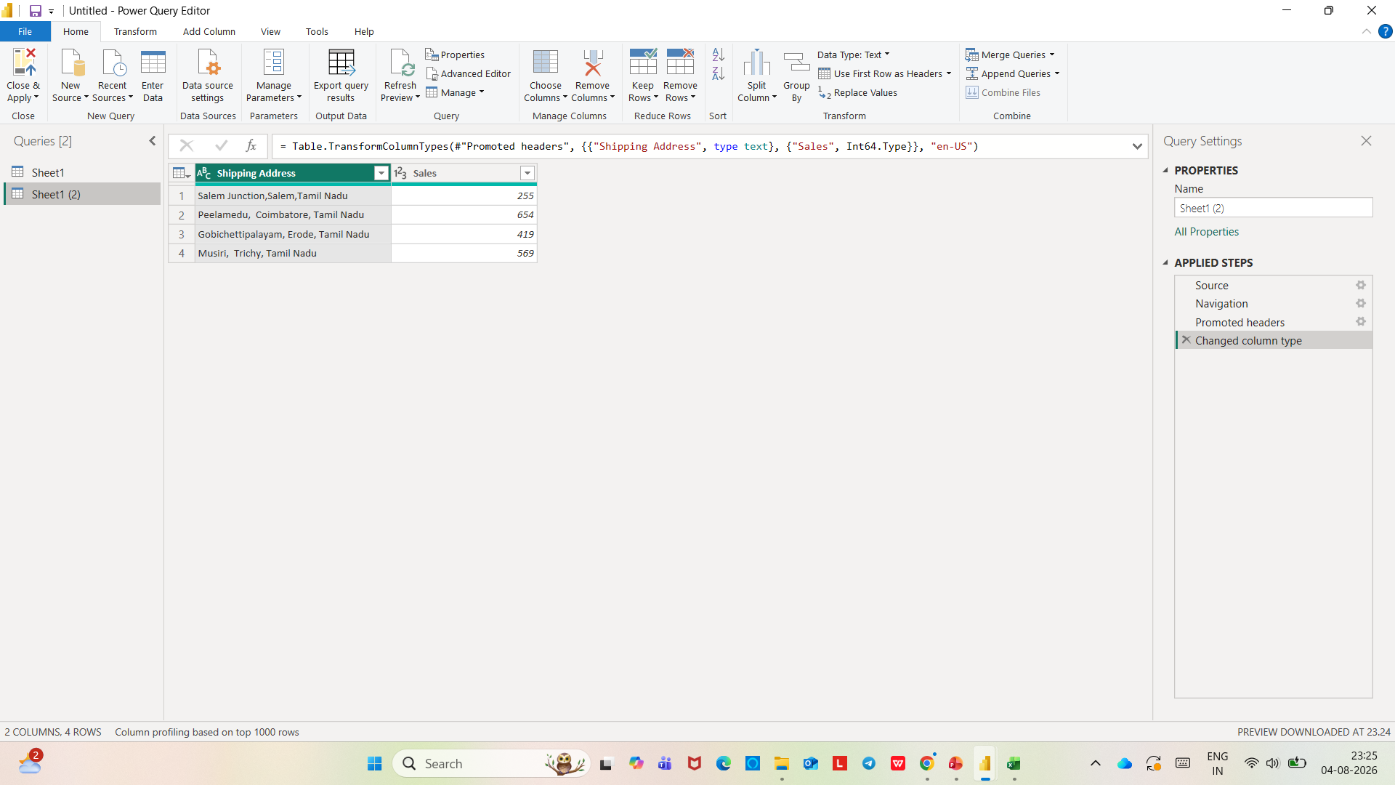

Slide 15
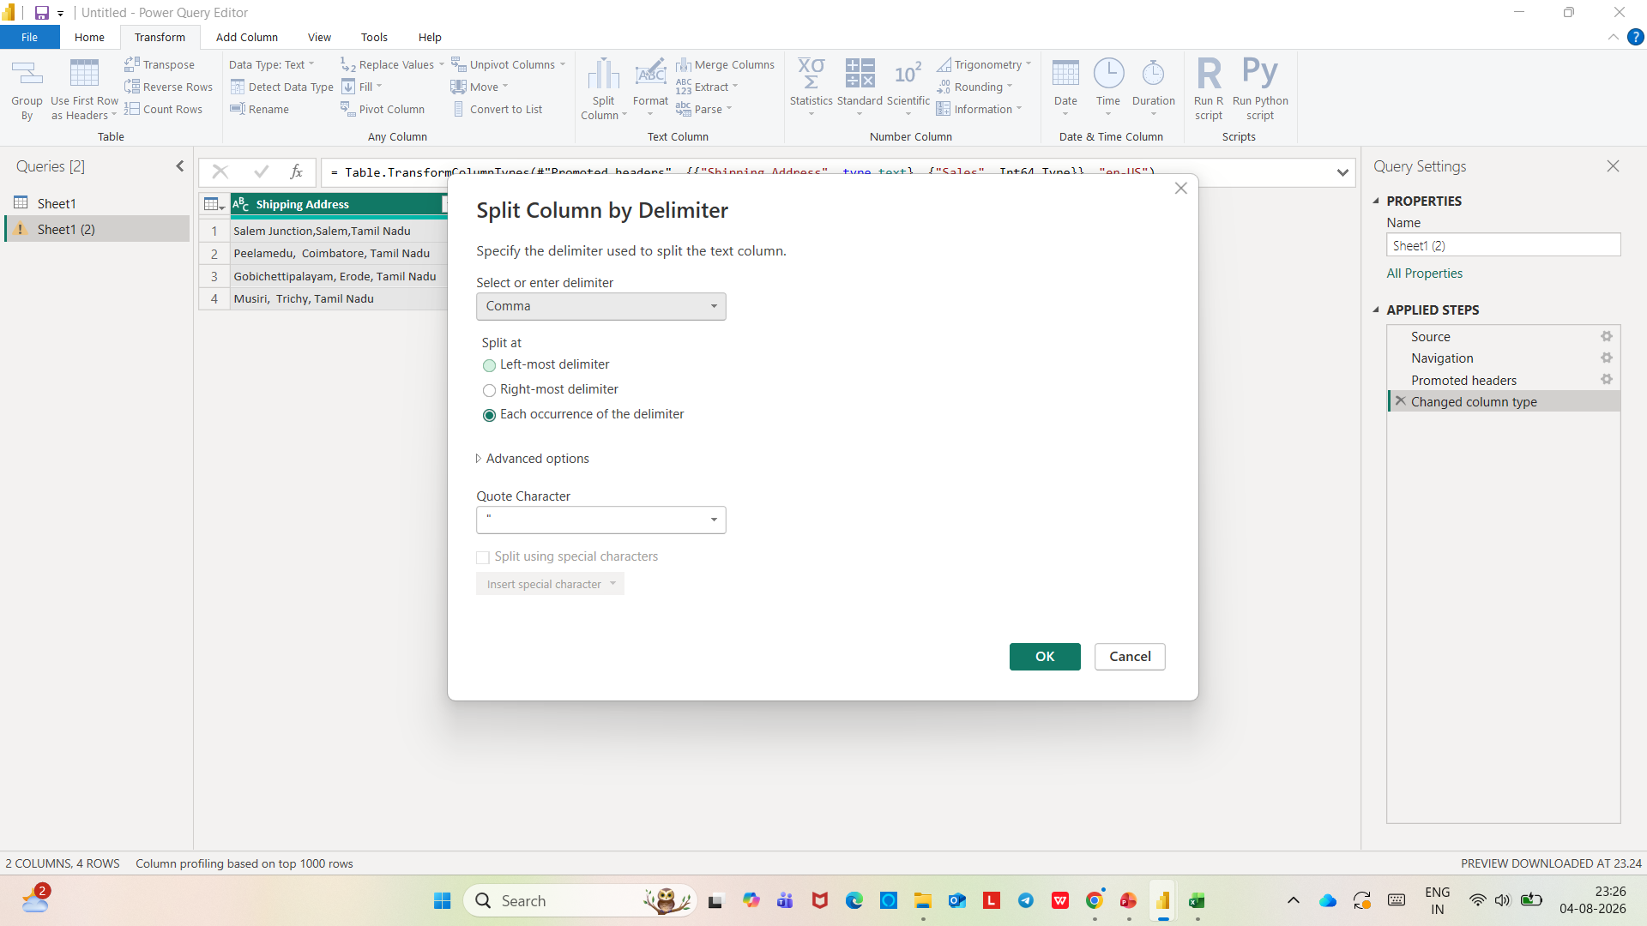

Slide 16
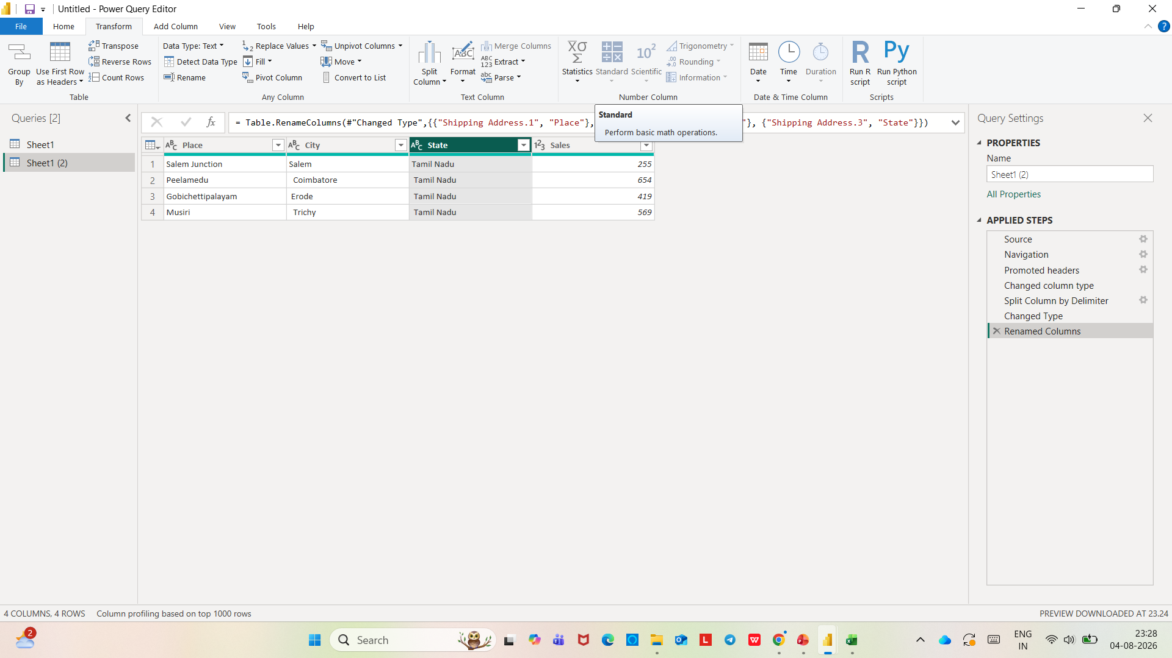

Slide 17
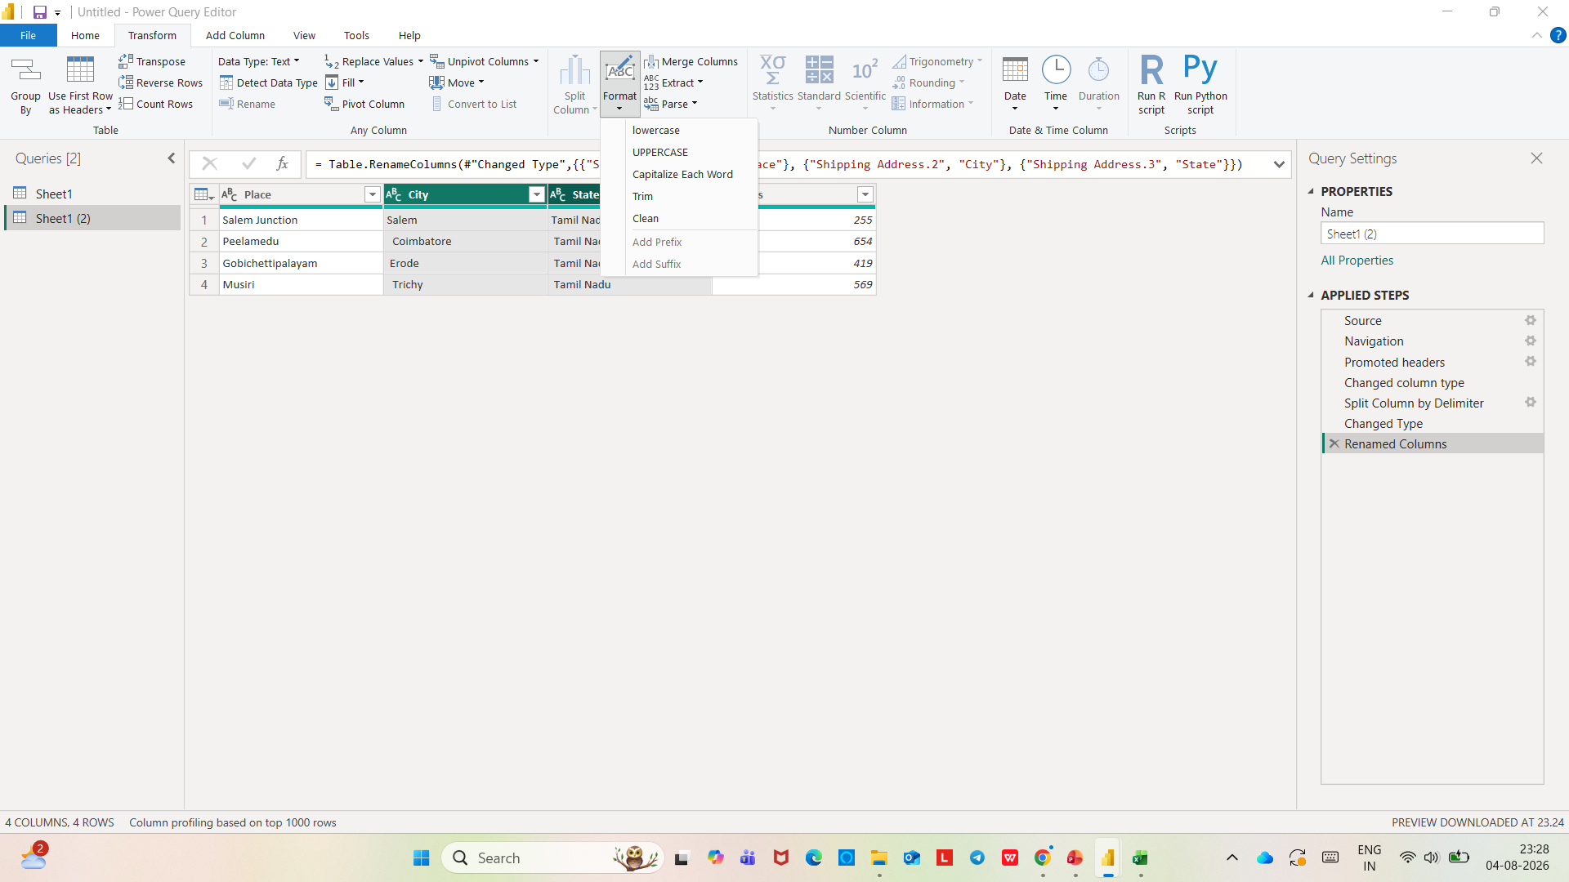

Slide 18
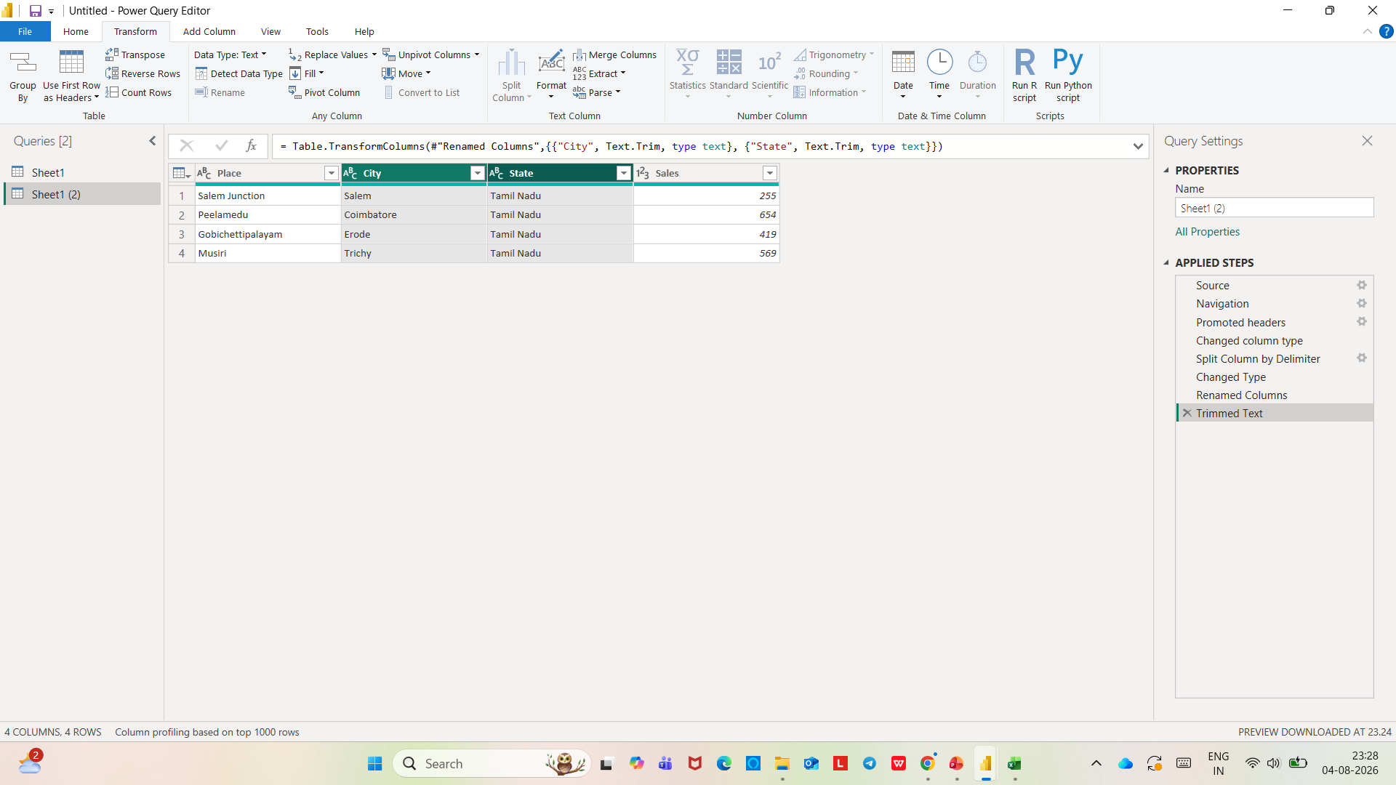

Slide 19
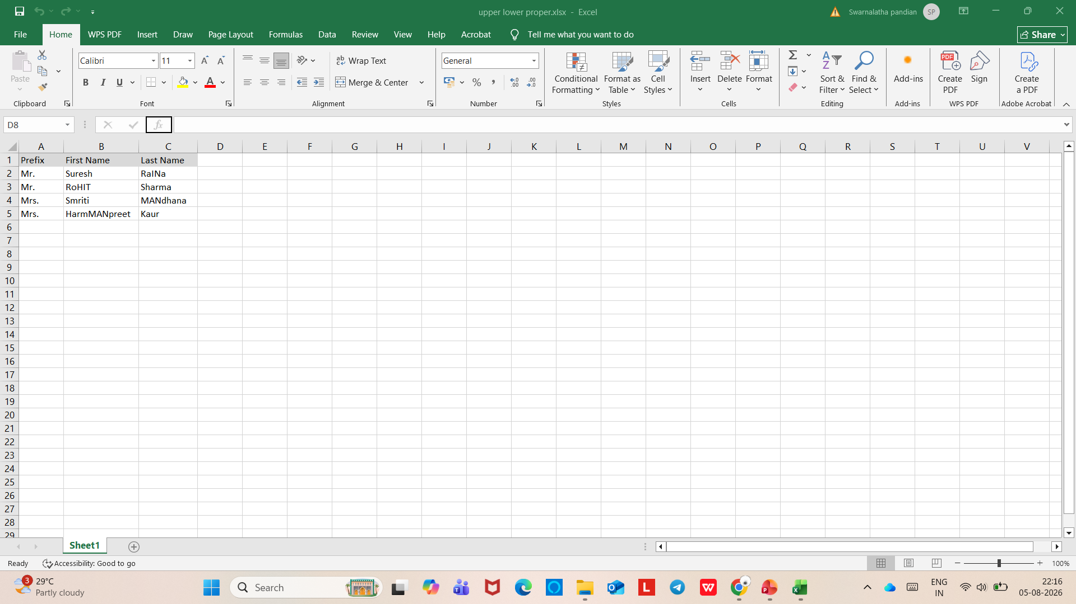
UPPER CASE, LOWER CASE AND PROPER CASE

Slide 20
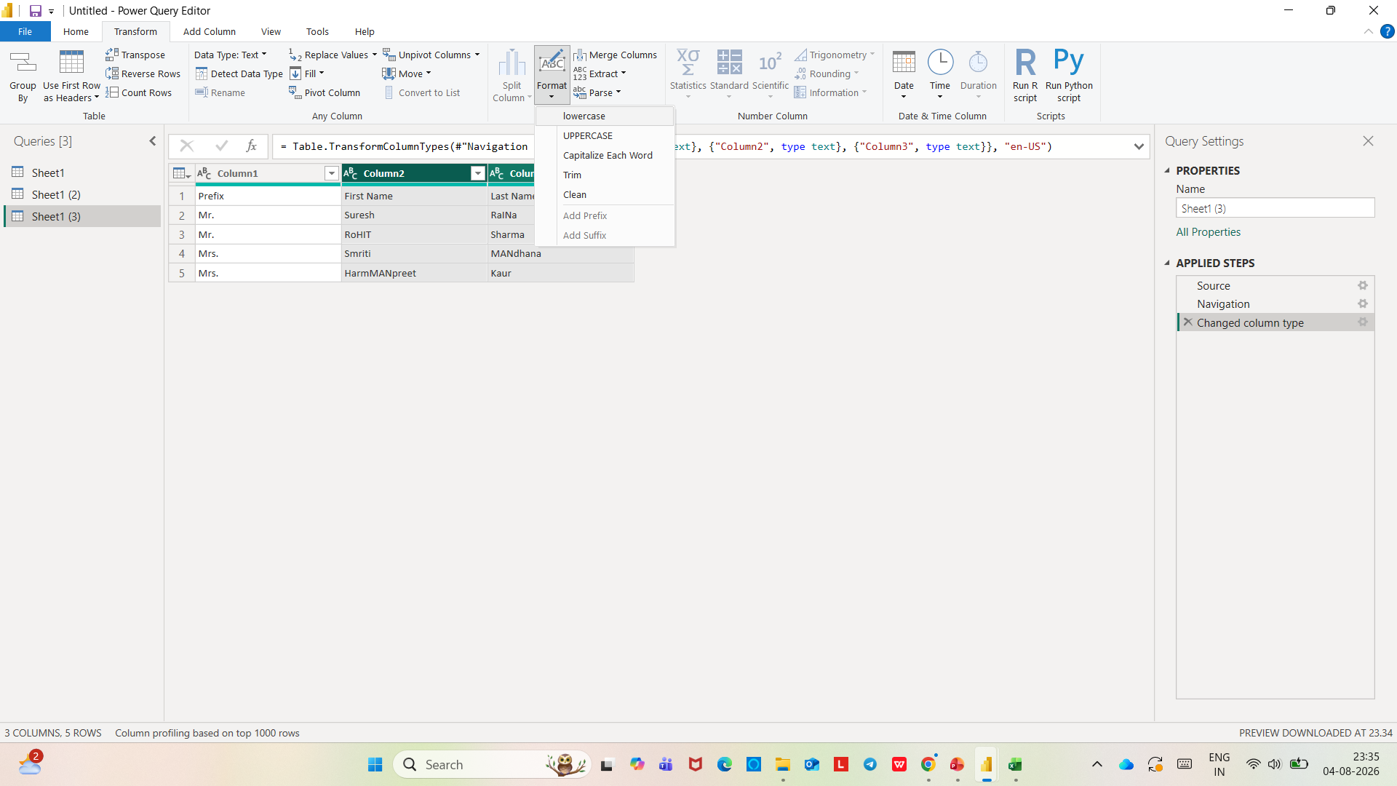

Slide 21
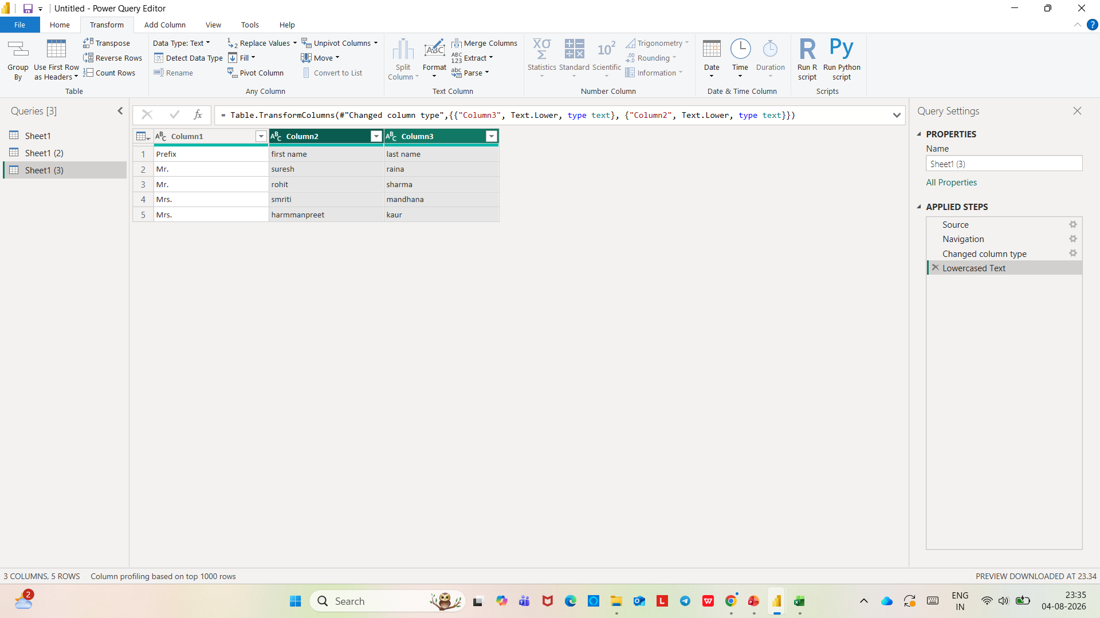

Slide 22


Slide 23
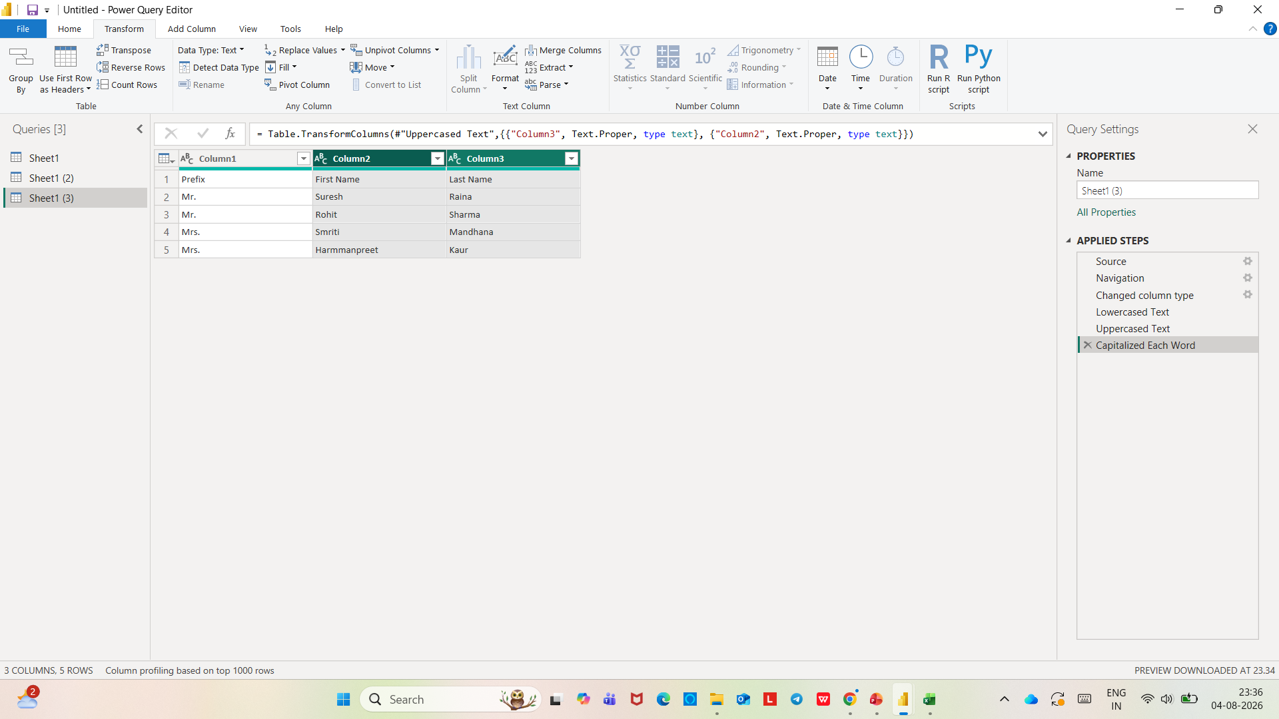

Slide 24
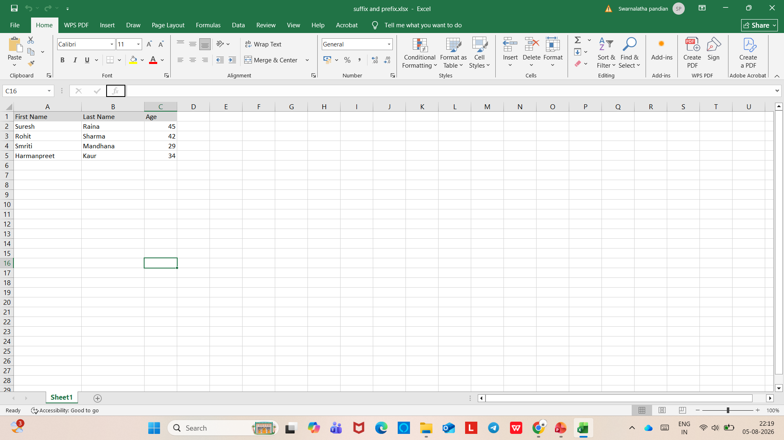
ADDING PREFIXES AND SUFFIXES

Slide 25
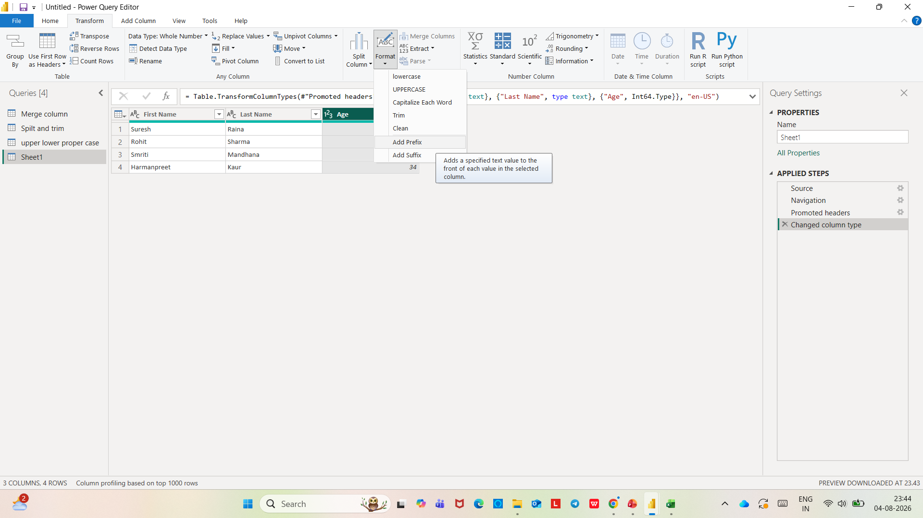

Slide 26
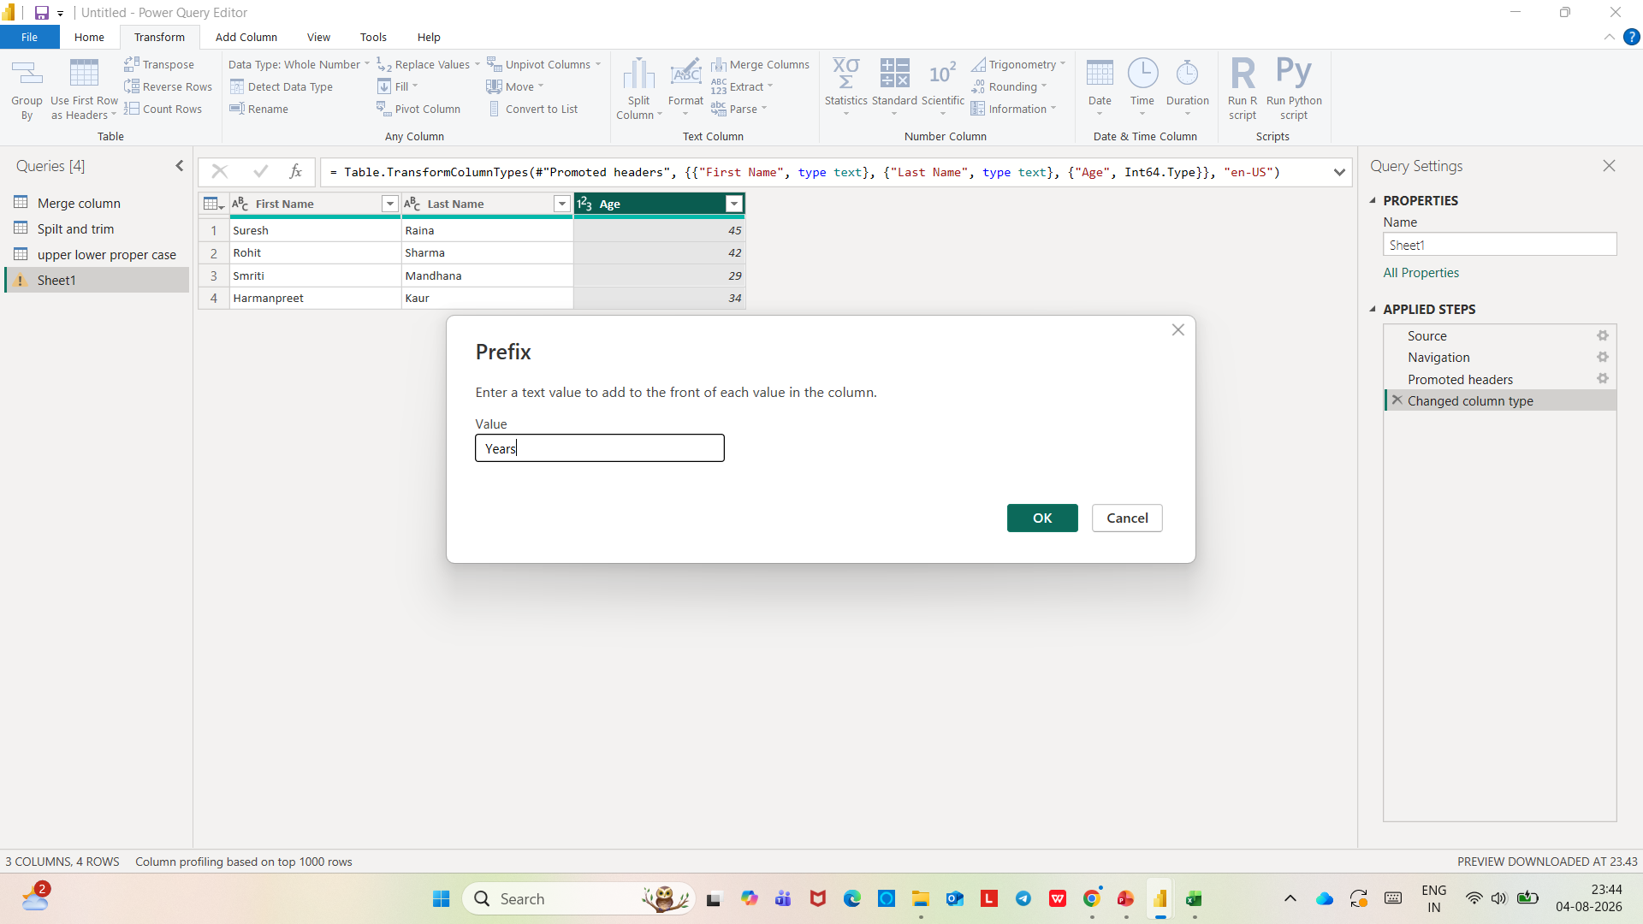

Slide 27
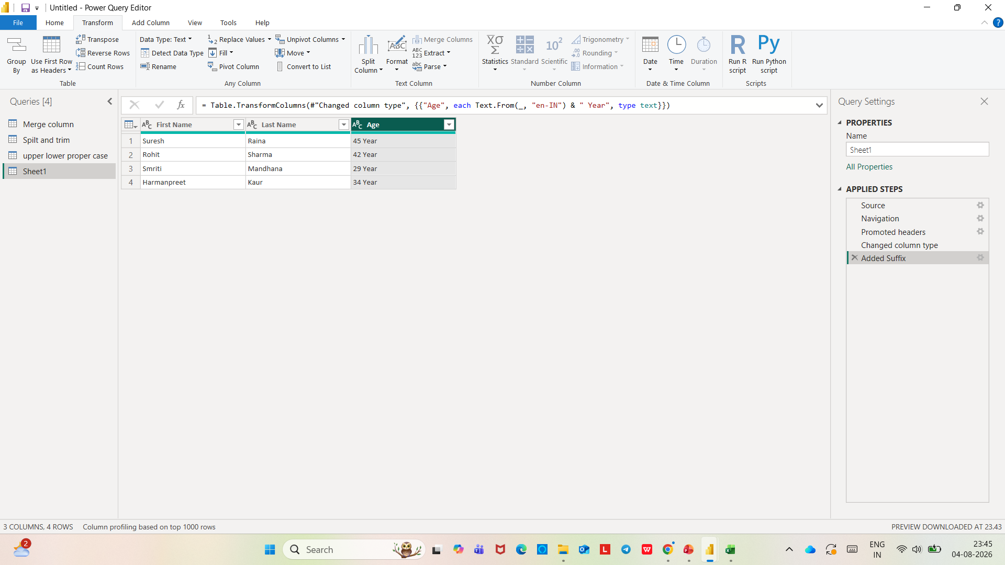

Slide 28


Slide 29
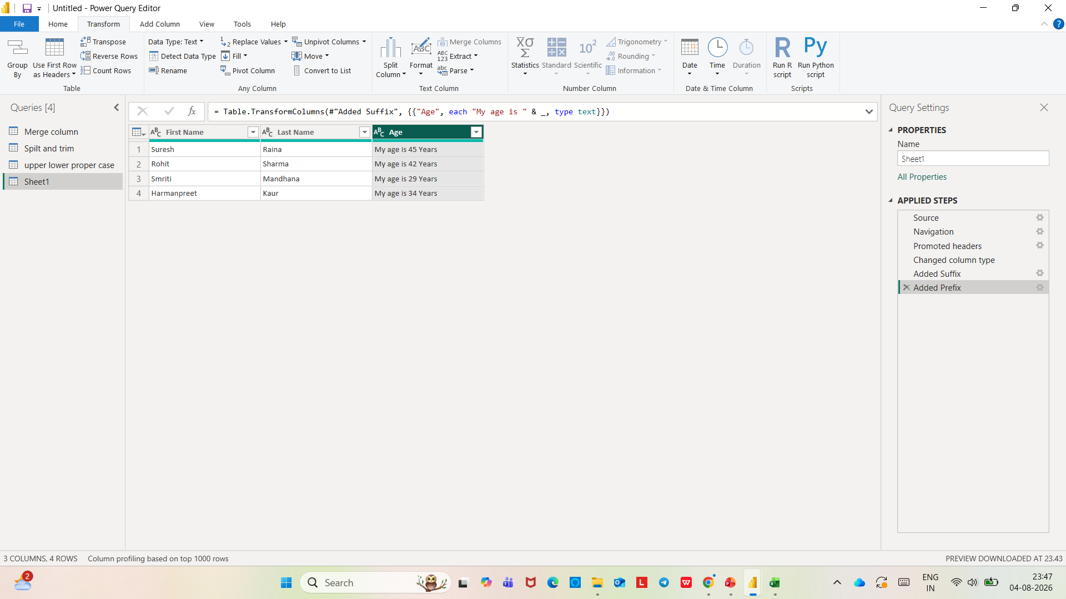

Slide 30
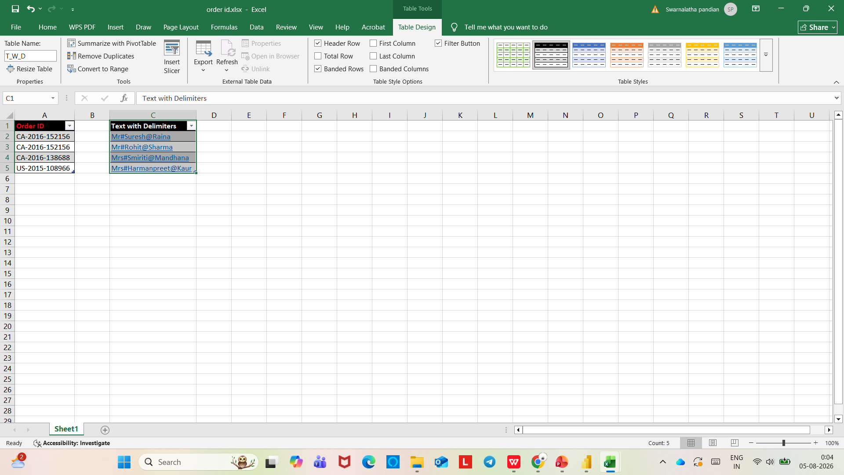
LEFT, RIGHT AND MID FUNCTION

Slide 31
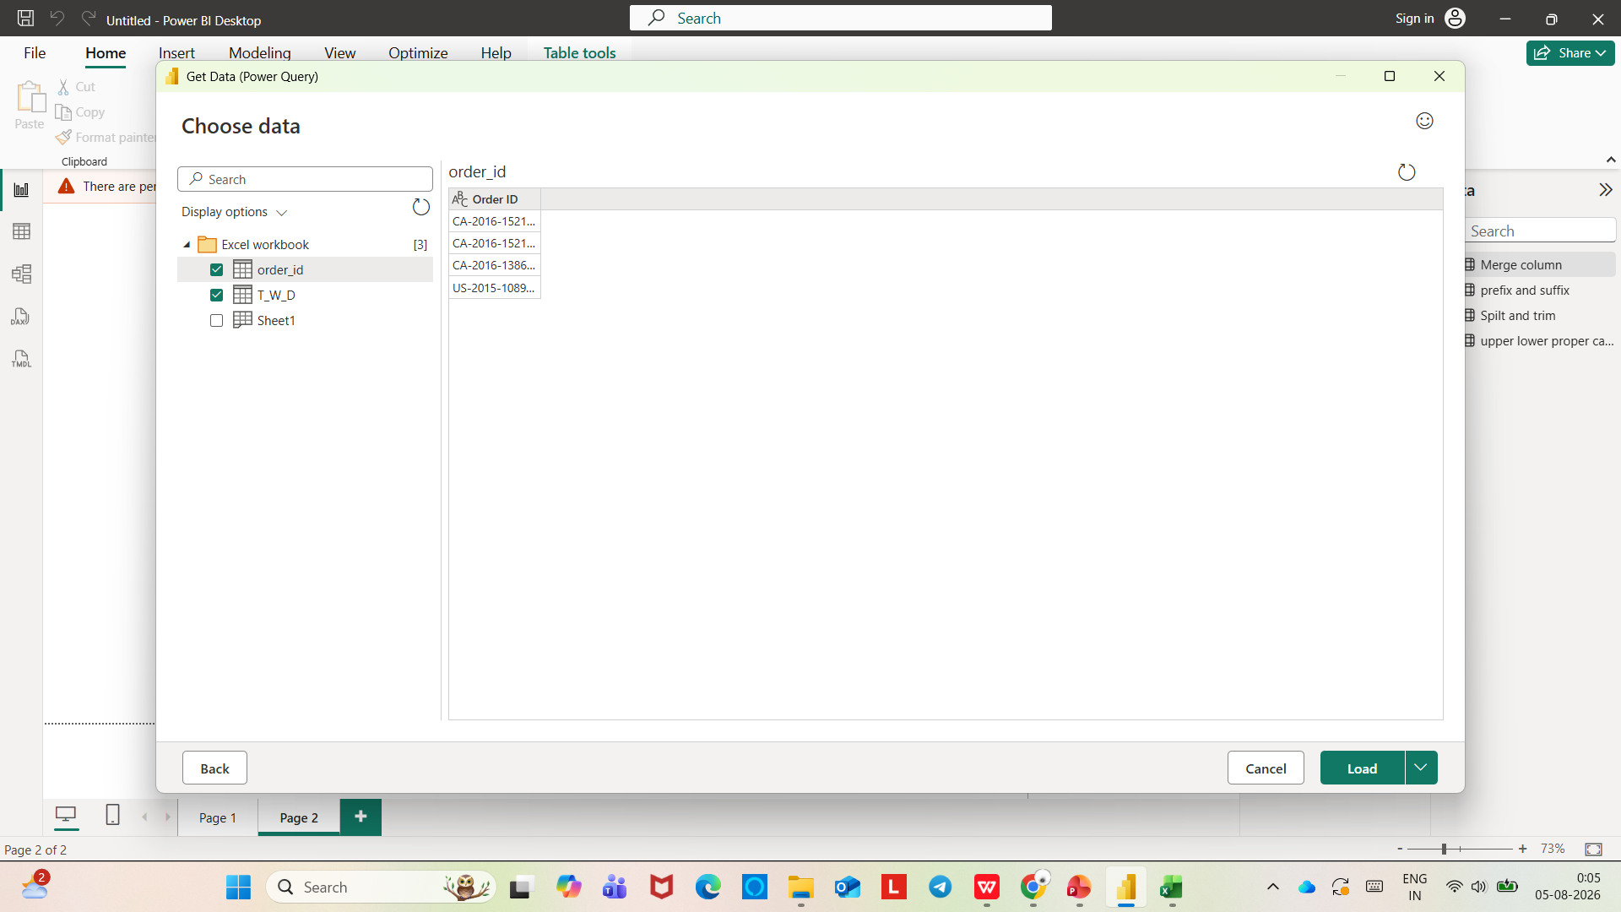

Slide 32
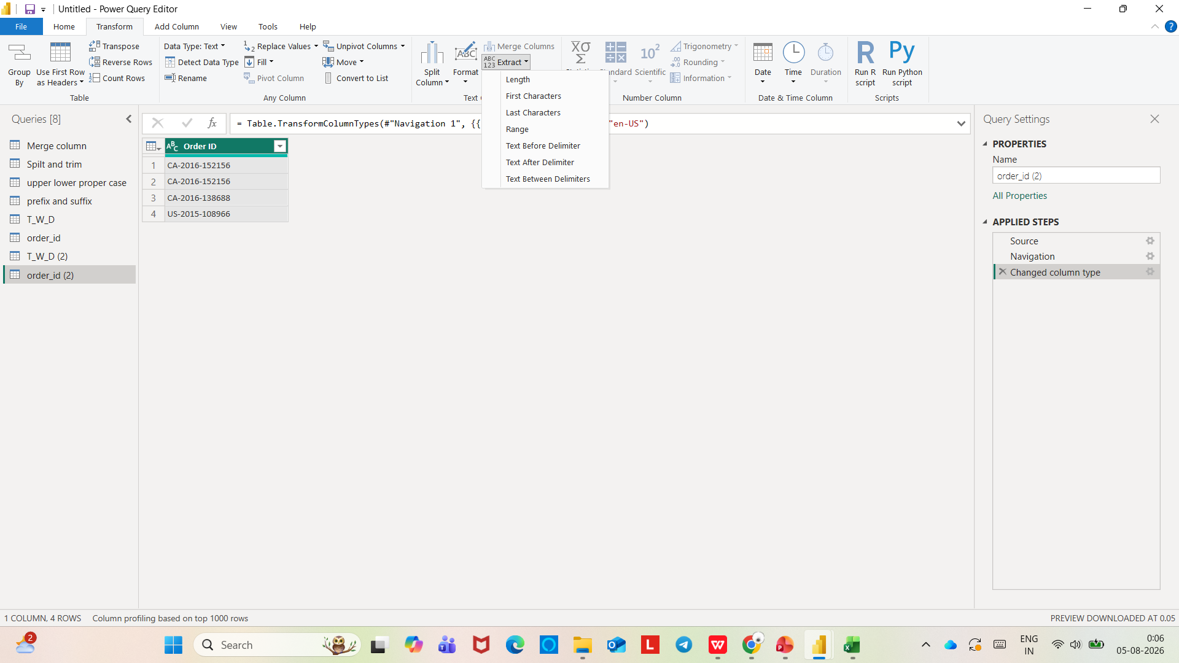

Slide 33
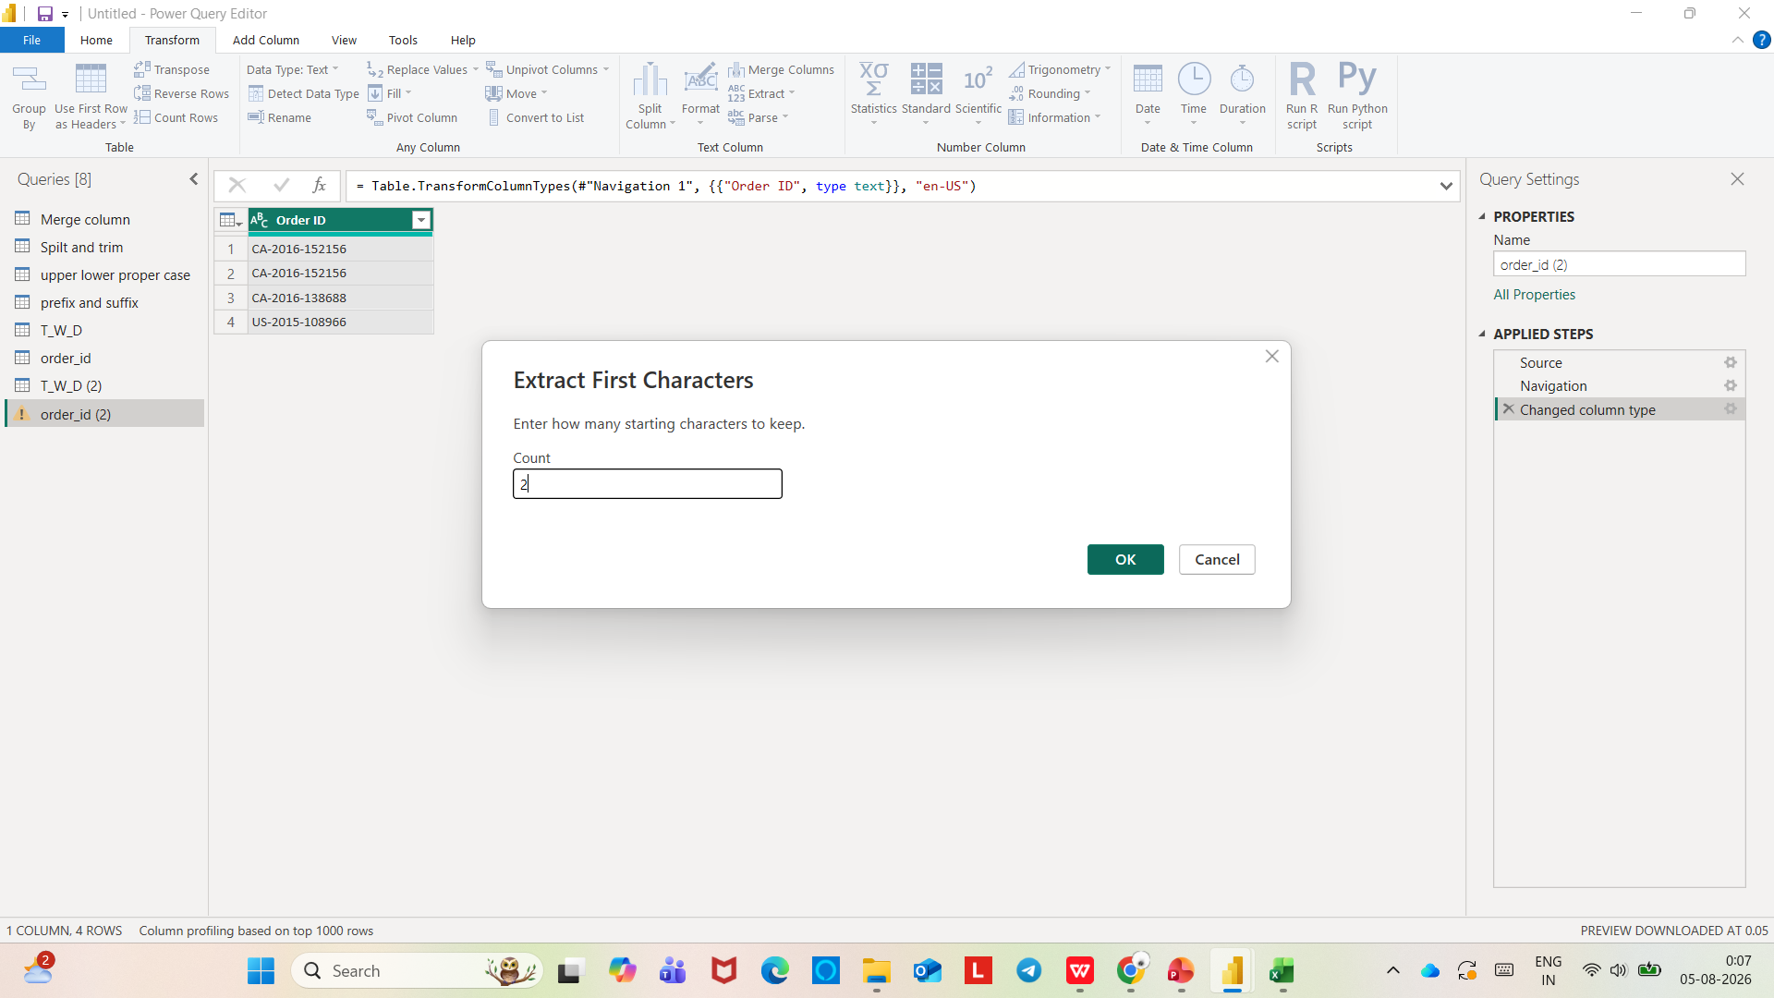

Slide 34
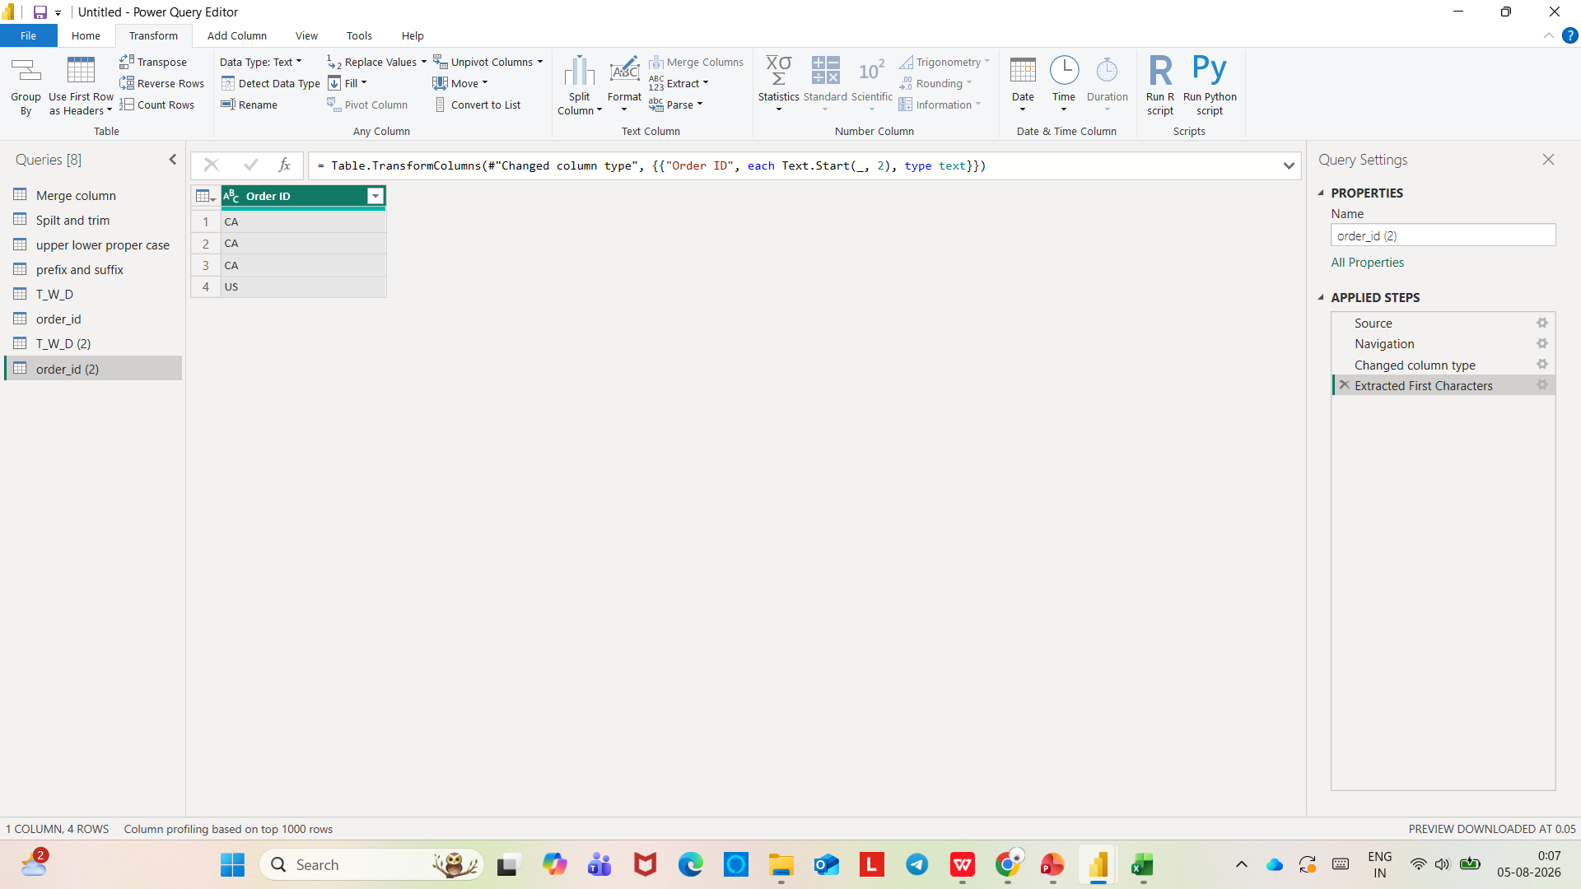

Slide 35
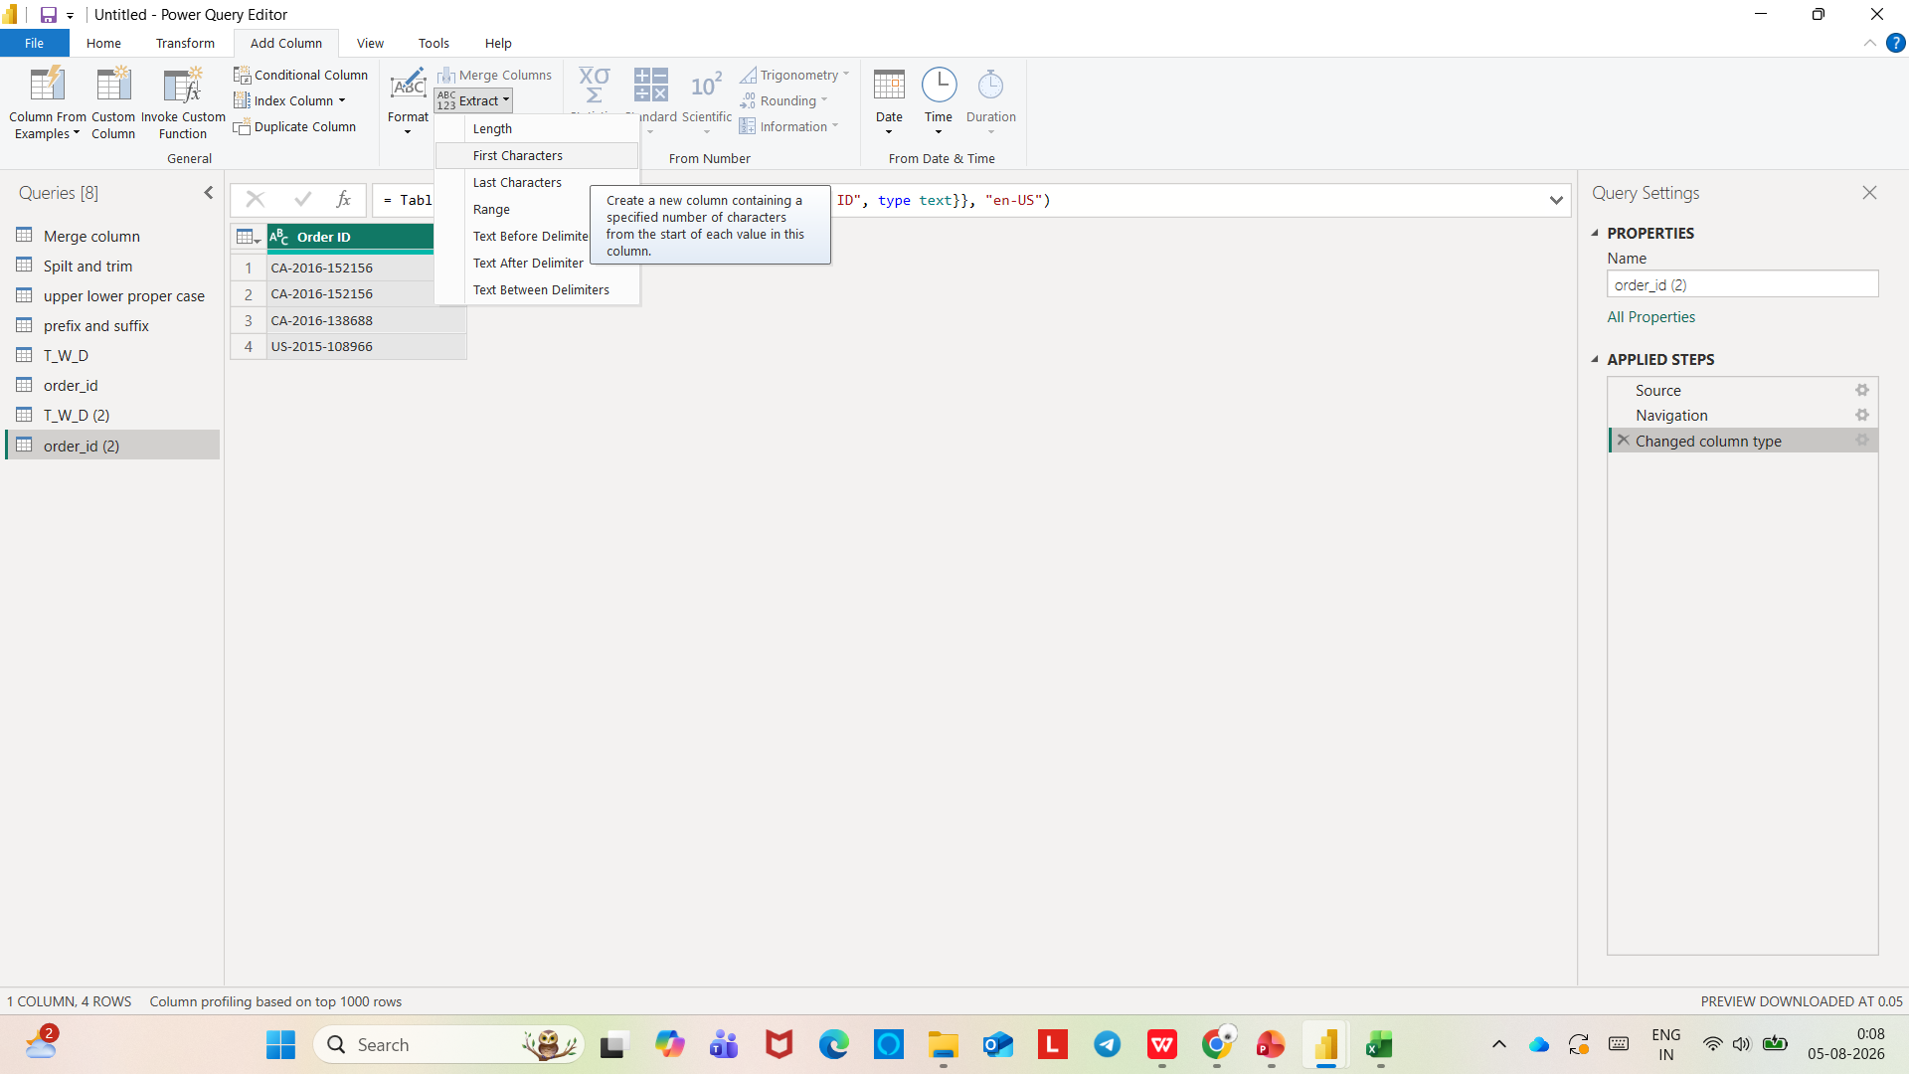

Slide 36
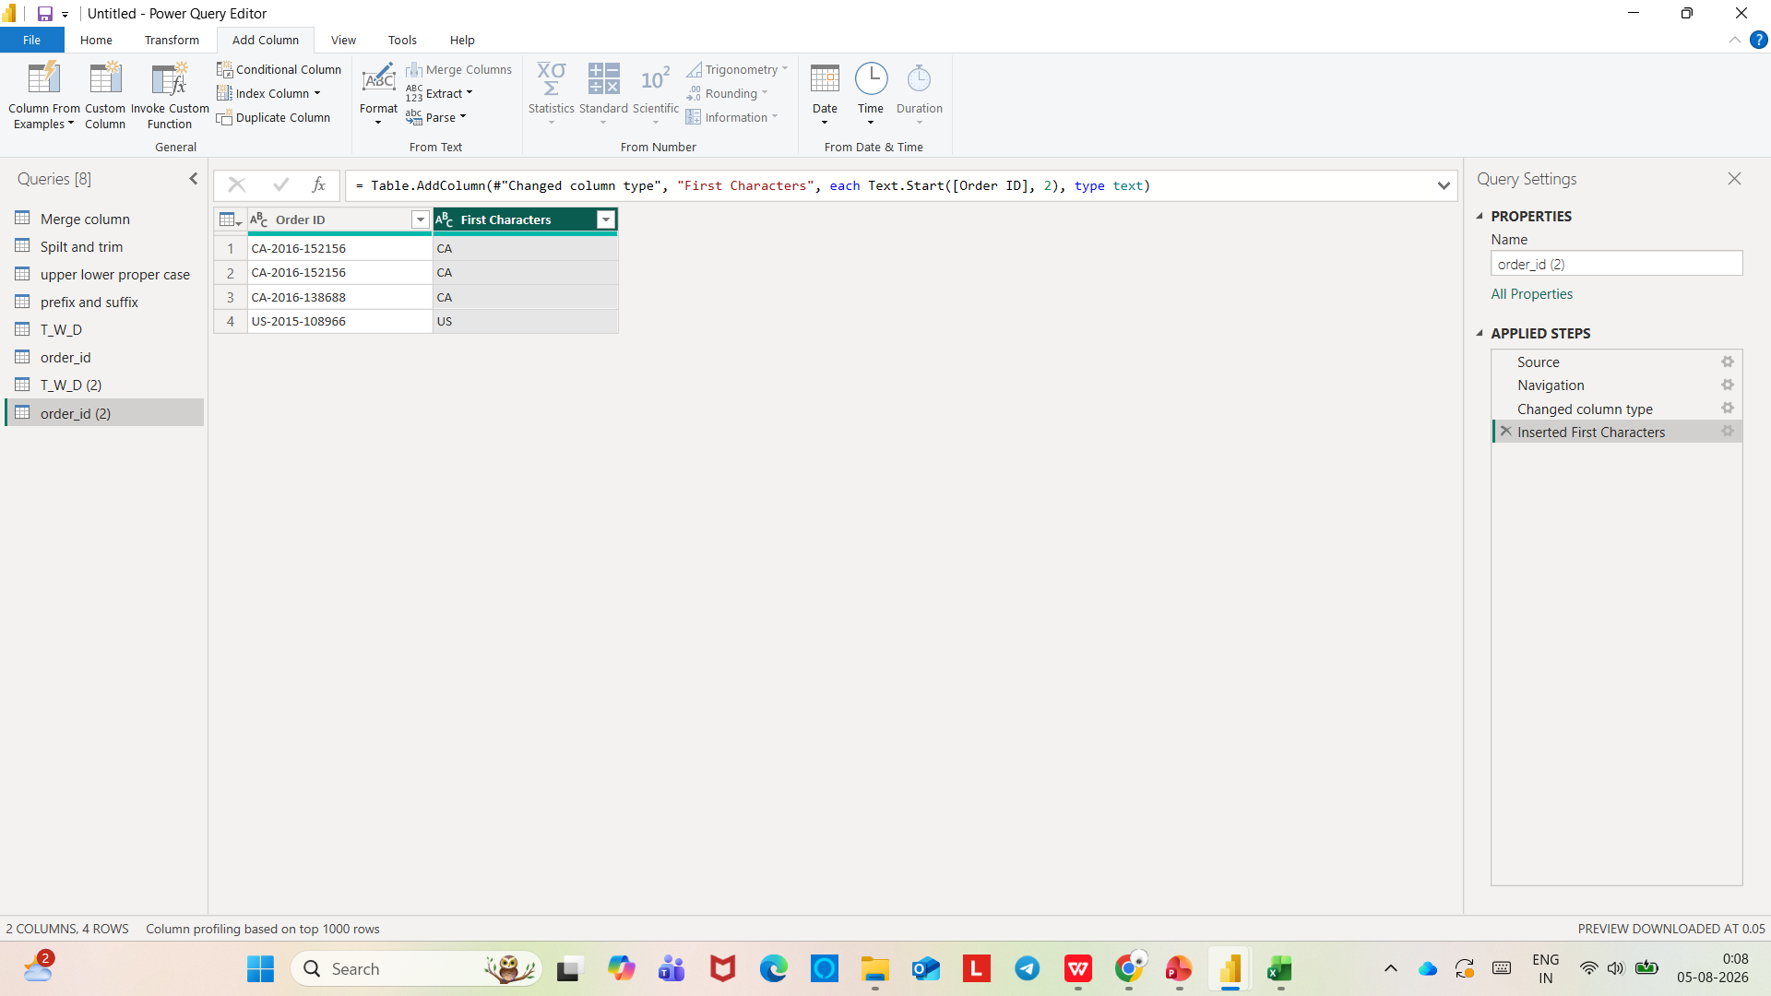

Slide 37
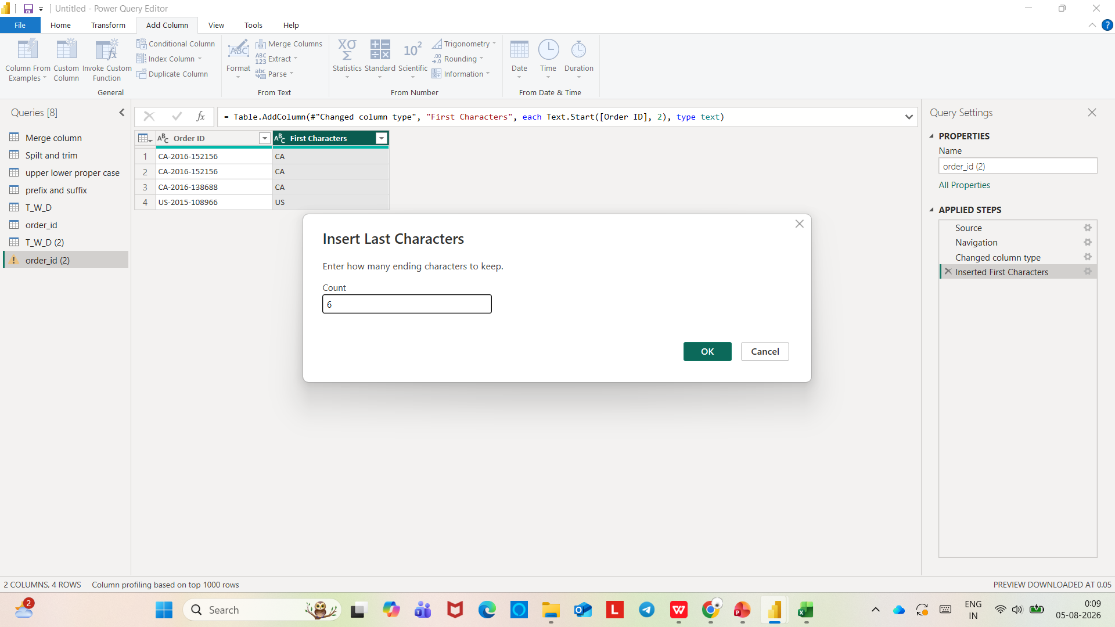

Slide 38
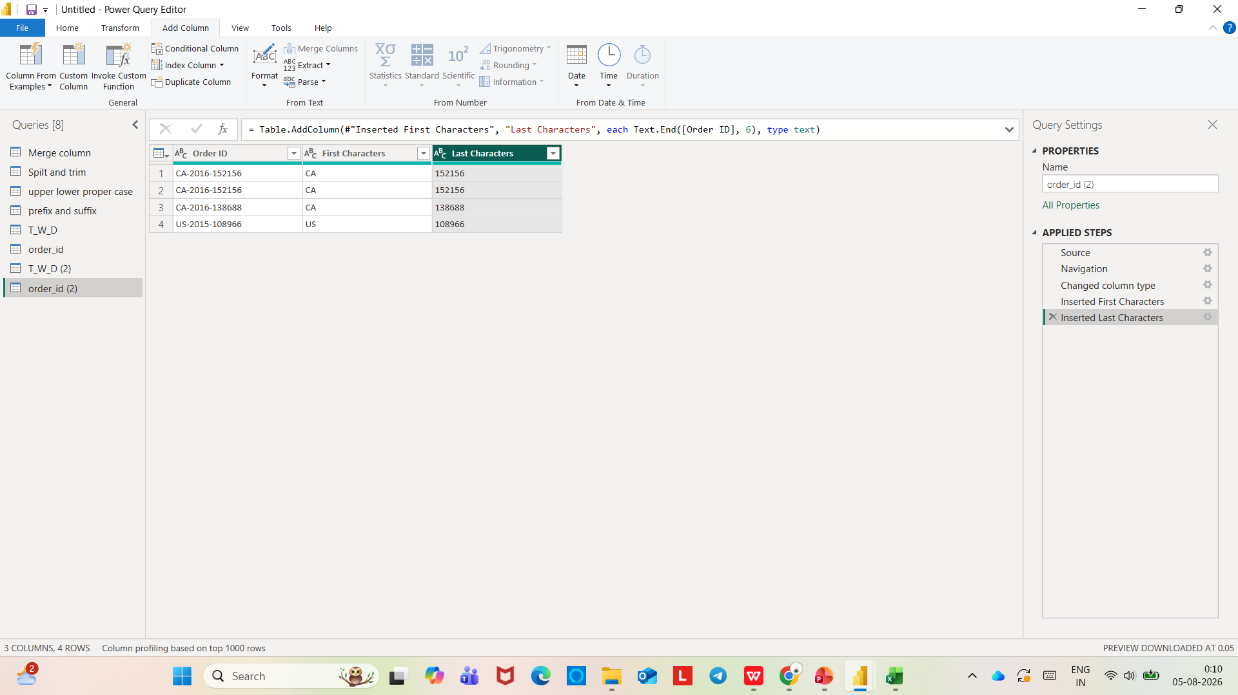

Slide 39
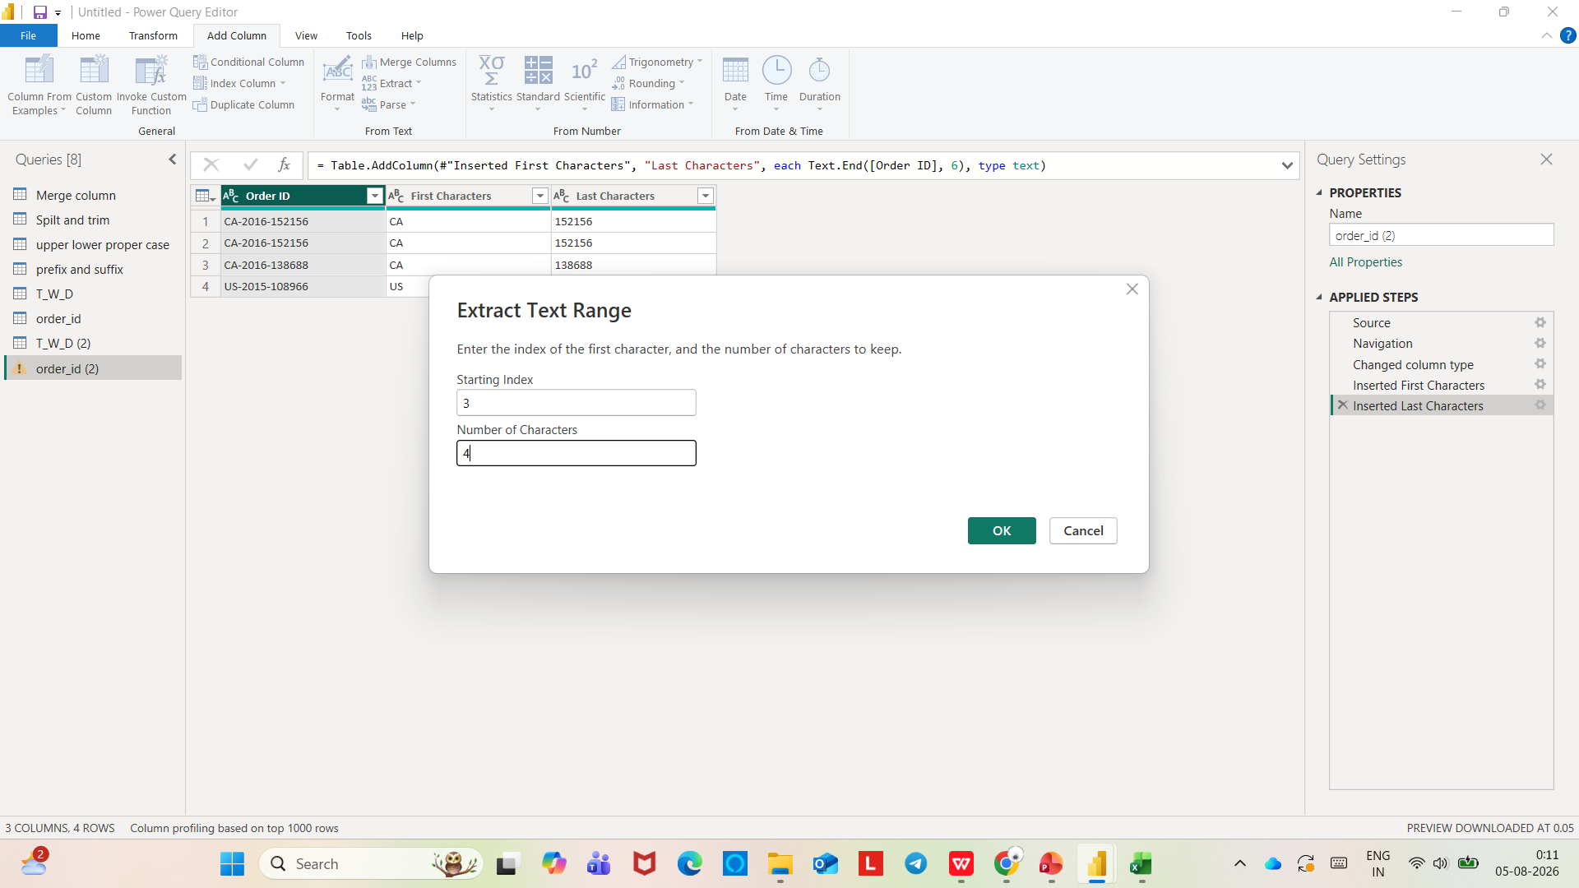

Slide 40
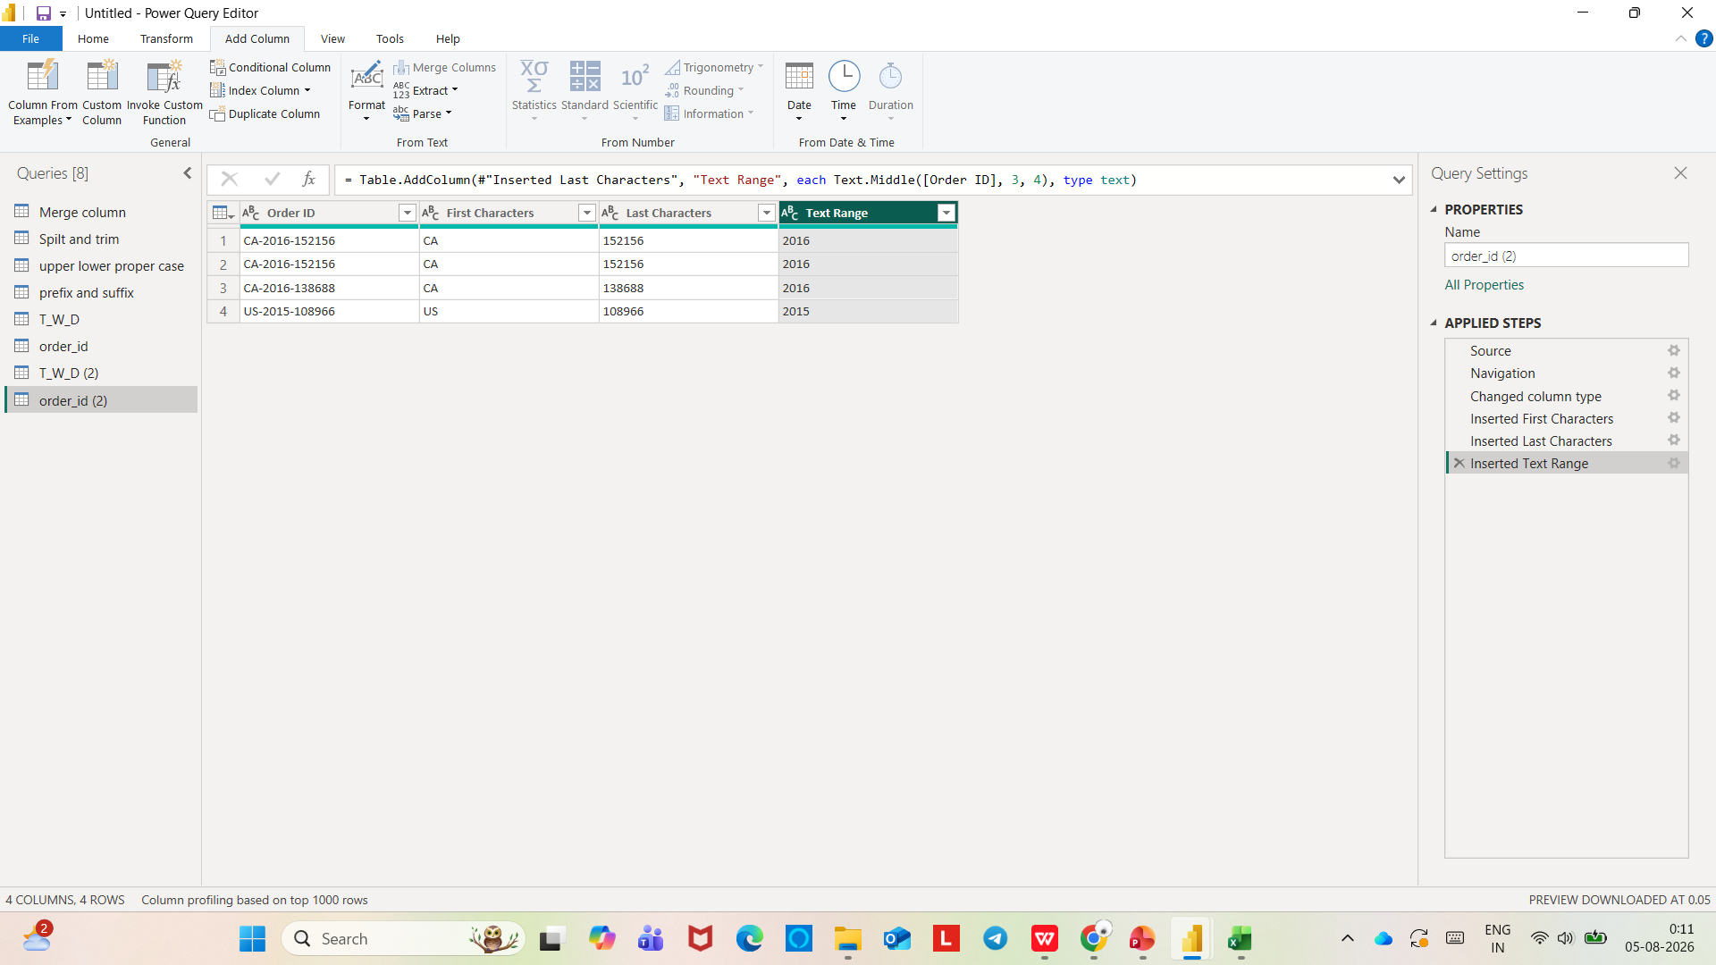

Slide 41
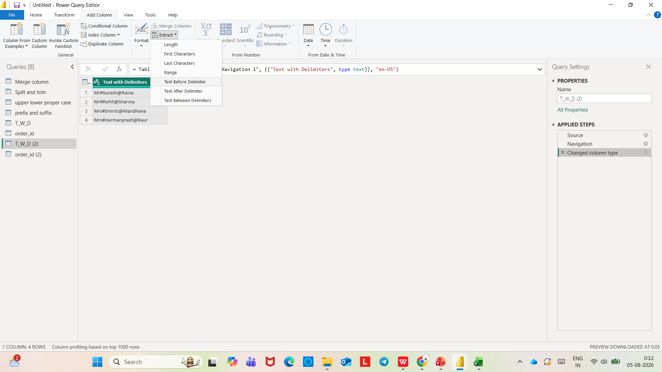
EXTRACTING TEXT WITH DELIMITERS

Slide 42
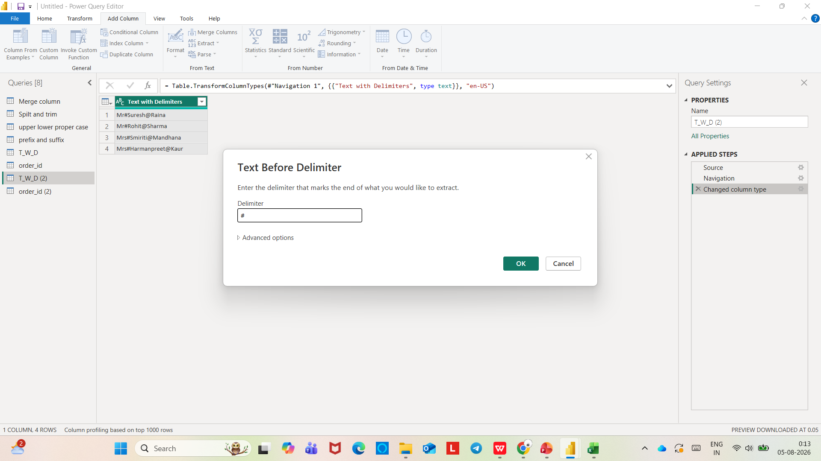

Slide 43
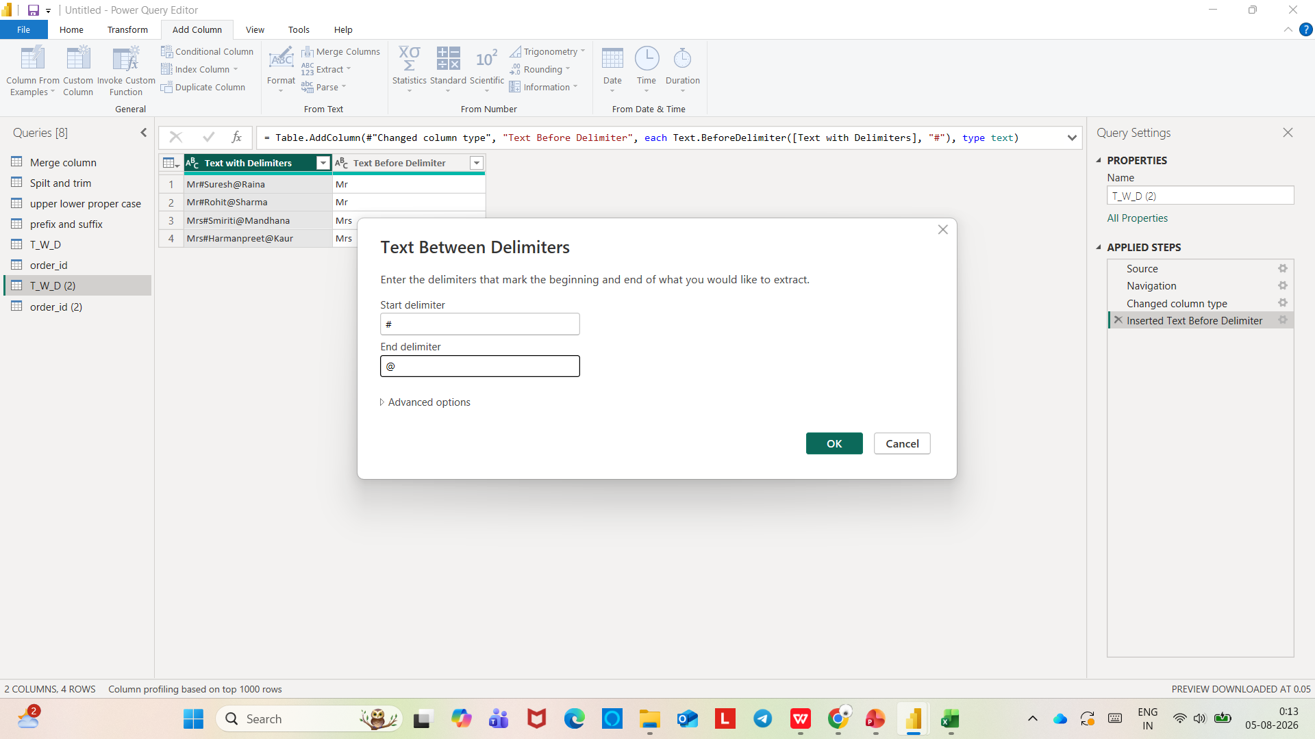

Slide 44
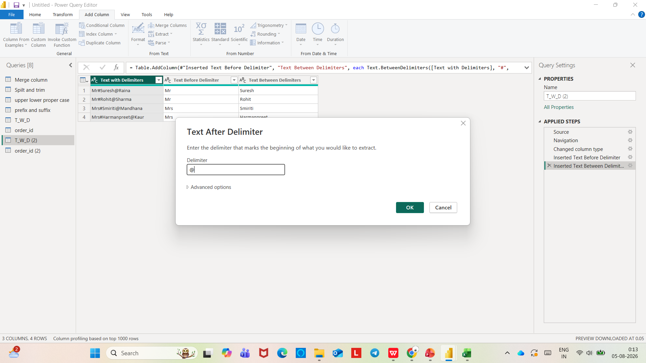

Slide 45
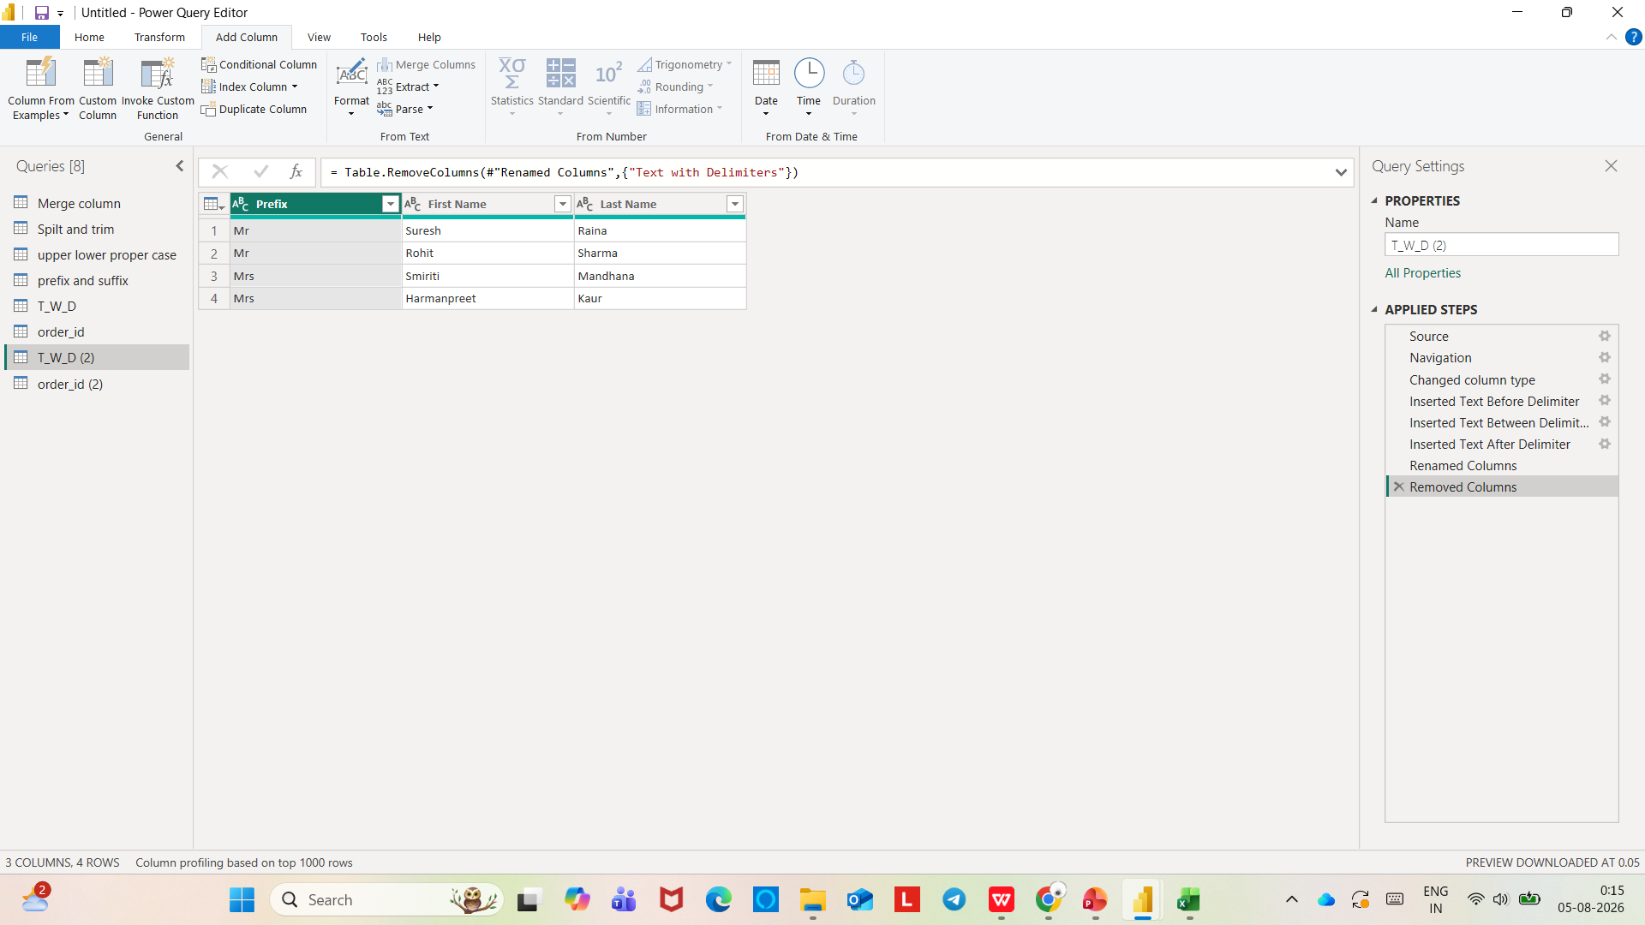

Slide 46
